Slide 1
Antibiotic Prophylaxis
Mark Downing
Infectious Diseases
Antimicrobial Stewardship
Saint Joseph’s Health Centre

Slide 2
Objectives
Rational approach to perioperative antibiotics
Antibiotics needed at all?
Which Antibiotic?
Penicillin Allergy
Timing
Dosing
Duration
Staph aureus decolonization

Slide 3
Why Antibiotic Stewardship Matters in the OR
Adjunct to source control
Minimize Adverse Events
Surgical Site Infections
Clostridium difficile
Allergic reactions
Decrease antimicrobial resistance, cost at the institution level

Slide 4
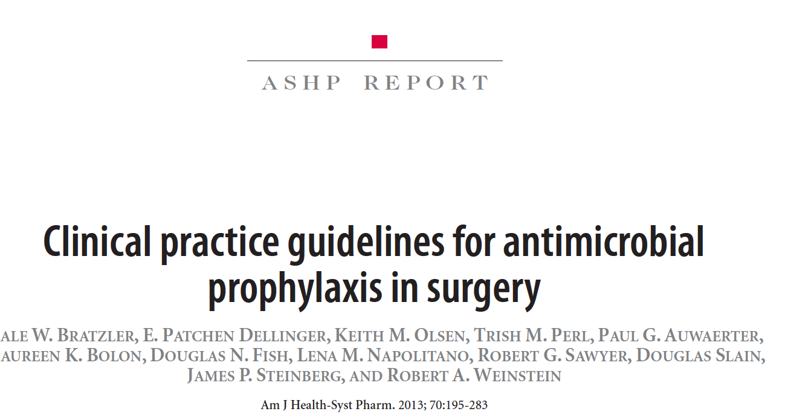

Slide 5
The Ideal Peri-operative antibiotic
Active against pathogens most likely to contaminate surgical site
Appropriate dosage for patient
Given at appropriate time to ensure adequate tissue levels at time of potential contamination
Safe
Administered for shortest effect period to minimize adverse events, resistance, cost

Slide 6
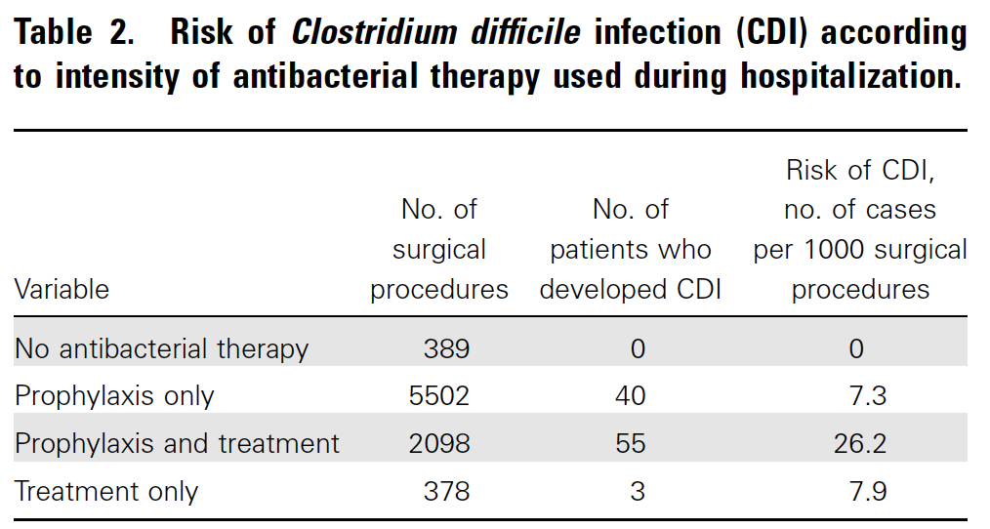
Antibiotic Prophylaxis Needed at all?

Slide 7
Antibiotic Prophylaxis Needed?
Already contaminated
Should be on treatment anyways
Clean-contaminated
Yes, for the most part
Laproscopic cholecystectomy in low risk patient: not needed
Clean procedures
Sometimes, if severe consequences of infection
Prostheses

Slide 8
Objectives
Rational approach to perioperative antibiotics
Antibiotics needed at all?
Which Antibiotic?
Timing
Dosing
Duration
Staph aureus decolonization

Slide 9
Deciding on an Antibiotic: Common Pathogens
Clean Procedures
Skin flora: Staph, Strep species (Gram positives)
Clean-contaminated
Skin flora, Gram negatives (eg. E.coli), Enterococcus, Anaerobes
Most reliable agents for gram positive organisms are Cefazolin, Clindamycin and Vancomycin

Slide 10
Common Perioperative Antibiotics
Cefazolin
The Work Horse
Active against most skin flora and some gram neg
Relatively narrow spectrum
Does not cover MRSA
?Cross reaction with penicillin allergy

Slide 11
Common Perioperative Antibiotics: Alternatives
Clindamycin
Increased resistance for Staph and Strep (20-30%)
Very high risk of C.diff
No gram negative coverage
Some MRSA coverage
Vancomycin
Reliably covers MRSA
Prolonged infusion time
Red Man Syndrome
Bacteriostatic
No gram negative coverage

Slide 12
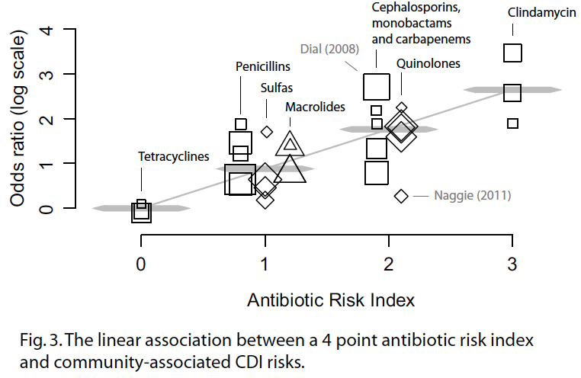
Clindamycin and C.diff

Slide 13
Vancomycin: Indications
Not recommended for routine use in any procedure
Patient MRSA colonized
Cluster of MRSA cases detected at institution
(True B-lactam allergy)

Slide 14
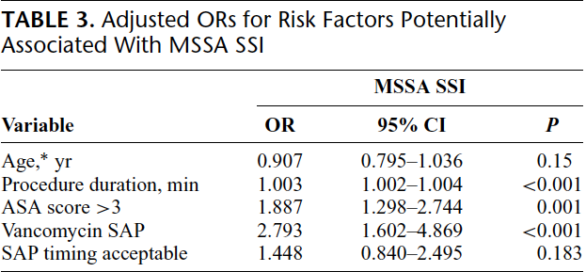
Vanco Less Effective than Ancef
Ann Surg. 2012 Dec;256(6):1089-92.

Slide 15
Vancomycin: Red Man Syndrome
Rate related infusion reaction to Vancomycin
Direct activation of mast cells
Not an allergy
Causes Rash, Pruritis, Pain, Hypotension
May be worsened by opiods, muscle relaxants
Infuse at a rate of <10 mg/min to avoid
May premedicate with Benadryl if high risk

Slide 16
Patient has a ‘penicillin allergy’: Can they still have Ancef?
JAMA. 2001 May 16;285(19):2498-505.

Slide 17
What type of allergy?
Type I: <72 hours, usually <1 hour
IgE mediated: anaphylaxis, wheezing, angioedema, urticaria
Type II, III, IV: Usually >72 hours
Serum Sickness
Hemolysis
Contact dermatitis, Stevens Johnson Syndrome
Idiopathic: >72 hours
Maculopapular rash

Slide 18
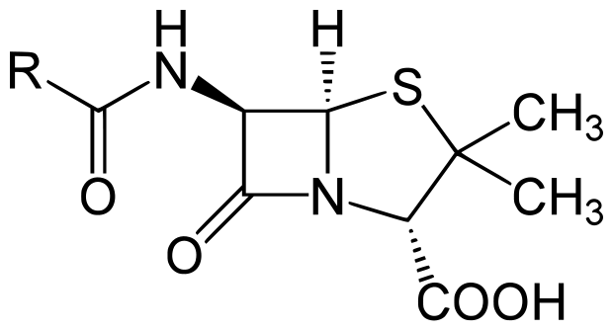
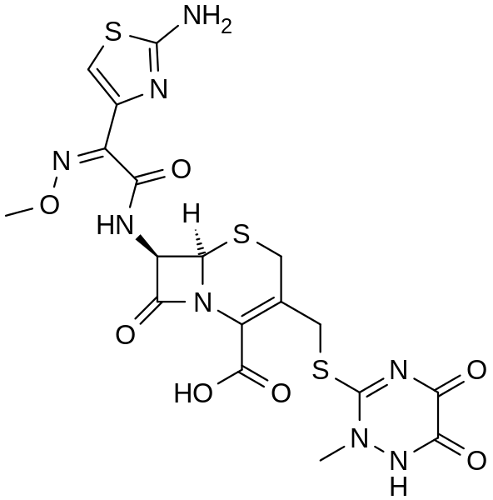
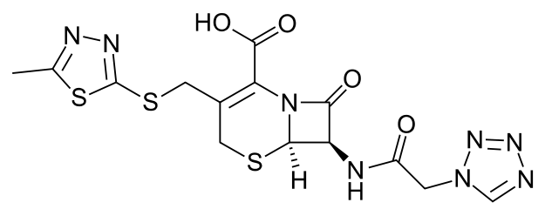
Cephalosporins
Penicillin
Ceftriaxone
B-lactam Ring
Cefazolin

Slide 19
Cross-Reactivity
Traditionally cross reactivity ‘10%’ with cephalosporins
Penicillin allergic pts 3x more likely to react to any drug
‘Allergy’ was loosely defined
In 70s cephalosporins were produced by mold which contained trace amounts of penicillin

Slide 20
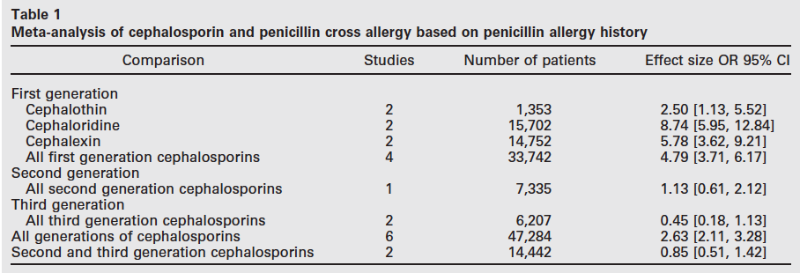

Slide 21
Does This Patient Have A Penicillin Allergy?
Age at time of reaction
Does the patient remember it?
How long after beginning penicillin did reaction occur?
Why was it given?
What other meds was the patient taking?
Has the patient taken antibiotics similar to penicillin? If so what happened?

Slide 22
Penicillin Skin Testing
Use is only for patients with history suspicious for Type I allergy
Of these if skin test negative only 1.4% will have a Type I reaction to penicillin
Reactions were only urticaria and other mild skin
?Reliable cephalosporin skin testing

Slide 23
Approach to Penicillin Allergy
History Suspicious for Type I
No
Give Cephalosporin
Yes
Skin Testing
Negative
Give Cephalosporin
Positive
Desensitize

Slide 24
Choosing an antibiotic: Summary
Cefazolin is great
Is there a really good reason not to use it?
Clinda causes C.diff, unreliable coverage
Vanco is useful for MRSA, true penicillin allergy
Most patients don’t have a true penicillin allergy and can safely be given Cefazolin
History is key

Slide 25
Objectives
Rational approach to perioperative antibiotics
Antibiotics needed at all?
Which Antibiotic?
Timing
Dosing
Duration
Staph aureus decolonization

Slide 26
Timing
Minimum Inhibitory Concentration (MIC) = Amount of drug needed to prevent organism from growing
Need to make sure antibiotic levels are above the MIC throughout procedure

Slide 27
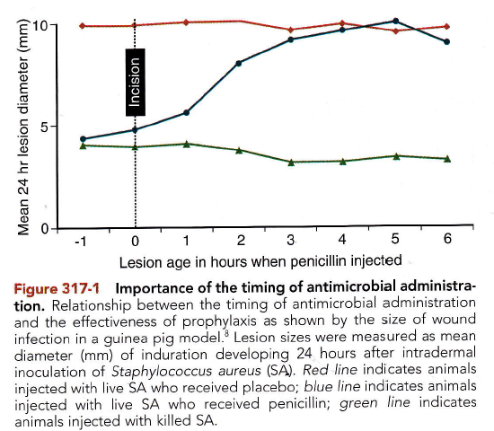
Placebo + Live Staph Aureus
Penicillin + Staph aureus
Dead Staph aureus

Slide 28
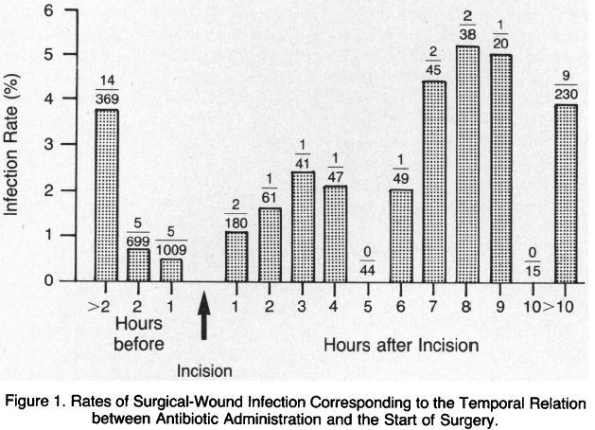
N Engl J Med. 1992 Jan 30;326(5):281-6.

Slide 29
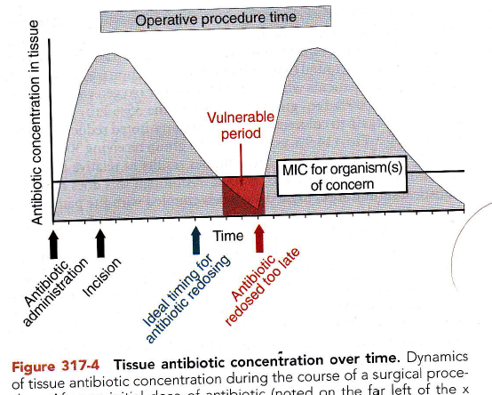
Multiple dose antibiotics for long procedures

Slide 30
Dosing
Weight based dosing and Cefazolin
1 gram <80 kg
2 grams for >80 kg
3 grams for >120 kg
Clindamycin 900 mg
Vancomycin 15 mg/kg
1 gram < 90 kg (60 min infusion)
1.5 grams 90-110 kg (90 min infusion)
2 grams for >110 kg (2h infusion)

Slide 31
Duration of Antimicrobial Prophylaxis
Should be <24 hours for most procedures
Generally very little evidence to support any post-operative prophylaxis
7 Studies evaluating single dose vs 1-4 day prophylaxis for cardiothoracic procedures
No reduction in SSI

Slide 32
Observational study
>48h vs <48h of antibiotic prophylaxis
Prolonged antibiotics not associated with decreased SSI in multi-variate analysis
Prolonged antibiotics associated with increased acquisition of resistant organisms (OR 1.6)

Slide 33
Objectives
Rational approach to perioperative antibiotics
Antibiotics needed at all?
Which Antibiotic?
Timing
Dosing
Duration
Staph aureus decolonization

Slide 34
Staph aureus
Staph aureus can colonize nares, skin
20-30% of patients are Staph aureus nasal carriers
~15% of our Staph aureus is MRSA
2-14x risk of SSI

Slide 35
Double Blind RCT intranasal mupirocin for elective/nonemergent surgery
3864 patients randomized
No difference in SSI between groups overall
50% reduction in SSI with Staph aureus in patients colonized with Staph aureus

Slide 36
Multi-centre RCT double blind study for medicine and surgical patients colonized with Staph aureus
Intranasal mupirocin + chlorhexidine bath x 5 days
Staph aureus hospital infection RR 0.42
Hospitalization shorter by 2 days

Slide 37
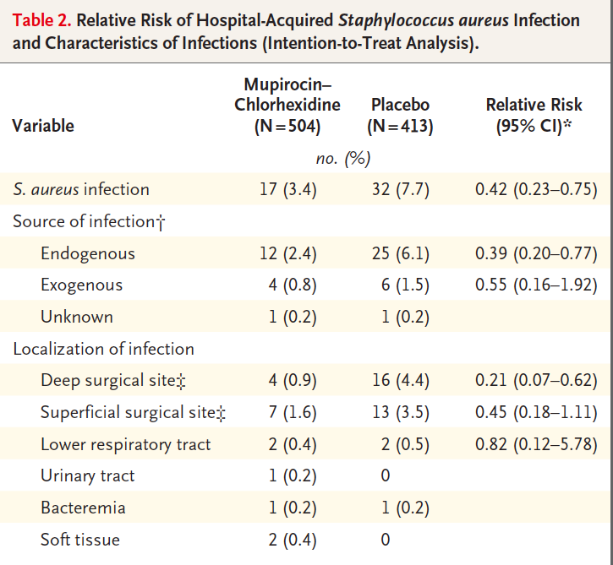

Slide 38
Staph aureus decolonization
Reasonable to screen patients at high risk for SSI
Cardiac Surgery
Orthopedic Surgery
(General Surgery?)
Does not matter whether its MSSA/MRSA
If patient has Staph aureus
Give Mupirocin 2% to both nares BID x >5 days + Chlorhexidine bath daily x >5 days

Slide 39
Antibiotic Prophylaxis for Common Surgical Procedures
Cardiac Surgery
Single dose of Ancef with appropriate intra-operative redosing
No evidence supporting durations >24h for abx regardless of whether drains in place
Vancomycin or Clinda for Pen allergy
Vancomycin for MRSA colonization

Slide 40
Antibiotic Prophylaxis for Common Surgical Procedures
Thoracics
Single dose of Ancef
Vanco/Clinda for Pen Allergy
Vanco for MRSA colonization
If high rate of Gram negative SSI need to add gram neg coverage to vanco or Clinda
No evidence for post-op prophylaxis >24 h

Slide 41
Antibiotic Prophylaxis for Common Surgical Procedures
General Surgery
Single dose of Ancef for Upper GI and Biliary procedures
Low risk Lap Cholecystectomy: no prophylaxis
Lower GI: Ancef + Flagyl
No post-operative prophylaxis generally needed

Slide 42
Antibiotic Prophylaxis for Common Surgical Procedures
Neurosurgery
Clean: Ancef x <48 hours
Orthopedics
Joint repair and replacements Ancef <24h

Slide 43
Antibiotic Prophylaxis for Common Surgical Procedures
Cystoscopy
None for clean procedures with no RF for infection
Treat pre-op positive urine cultures with appropriate agent
Clean procedures with instrumentation: Cefazolin, Fluoroquinolone, Septra

Slide 44
Surgical Antibiotic Prophylaxis Summary
Cefazolin is great, Clinda and Vanco are not
Most patients with ‘penicillin allergies’ do not have true allergies
Antibiotics should be given 30-60 min before incision (except for Vanco)
No evidence to support post-op antibiotic prophylaxis in most settings
Staph aureus screening and decolonization useful in select high risk procedures

