Slide 1
Surgical Foundations Infectious Disease Topics in Surgery
Surgical Emergencies in ID
Antibiotic Prophylaxis
Fever in the Post-op Patient
Common Nosocomial Infections
Hand Hygiene
Mark Downing and Jennie Johnstone
Division of Infectious Diseases
Saint Joseph’s Health Centre

Slide 2
Surgical Emergencies in Infectious Diseases
Mark Downing
Infectious Diseases/Antimicrobial Stewardship
Saint Joseph’s Health Centre

Slide 3
Disclosures
I am not a surgeon
I have not written your exam
I have written two other Royal College exams
They love cases where ID and Surgery meet
This is meant to be interactive
Participation encouraged
I will not pick on you (even though Blitz said I could)

Slide 4
Objectives
Go through common questions related to ‘Surgical Emergencies’ in Infectious Diseases using cases
Necrotizing Fasciitis
Deep Neck Space infections
Empyema
Spinal Epidural Abscess
Endopthalmitis
Endocarditis
Ie When are antibiotics not enough and patient needs source control

Slide 5
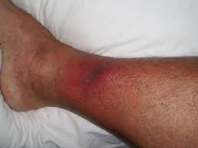
Case #1
55 yo male, history of diabetes
Right leg pain x 48 hours
Fever, tachycardic, hypotensive
Leg +++ tender
WBC 18, Creatinine 170 , Lactate 5
What is your next step?

Slide 6
Necrotizing Fasciitis
Plastics
Orthopedics
General Surgery
Urology
ENT

Slide 7
Necrotizing Fasciitis: Pathogenesis
Infection of muscle fascia and overlying subcutaneous fat
Spreads quickly due to poor blood supply
Overlying (skin) and underlying (muscle) tissues have better blood supply so often spared
Hard to diagnose nec fasc with physical exam
Ludwig’s Angina: H&N region
Fournier’s Gangrene
breach in GI or urethral mucosa causing perineal involvement

Slide 8
Nec Fasc: Clinical Features
Pain out of keeping of physical exam
Systemic toxicity
Rapid evolution
Compartment syndrome
Anaesthesia
Necrosis

Slide 9
How would you confirm the diagnosis?
Necrotizing Fasciitis is a surgical diagnosis
Clinical exam/tests not sufficient to rule in or out
Can do either bedside biopsy or take to OR depending on level of suspicion without delay
Useful adjunctive tests
CK
Xrays
CT/MRI

Slide 10
Case #1
Blood cultures drawn from yesterday positive for GPC in chains
How would you manage this patient beyond going to the OR for debridement?

Slide 11
Necrotizing Fasciitis: Antimicrobial therapy
Type I: Mixed anaerobes and aerobes (think Fourniers)
PipTazo + Clindamycin +/- Vanco
Type 2: Classically Group A Strep, also Staph aureus (including MRSA)
Ceftriaxone + Clindamycin +/- Vanco
B-lactams don’t work well with dense burden of organsims
Add Clindamycin (‘Eagle Effect’)
Group A Strep is a toxin-mediated disease
Add Clindamycin (protein synthesis)
Consider IVIG (evidence not great)

Slide 12
Case #1
Transferred to ICU for supportive care
Started empirically on PipTazo/Clinda/IVIG
To OR for extensive debridement left leg
Wound/Blood cultures confirmed to be Group A Strep
Antibiotics streamlined to Penicillin G/Clindamcin
Back to OR next day: margins clean

Slide 13
Nec Fasc: Follow-up
Patients should return to the OR in 24-48h to to reassess margins for evidence of spread
Wounds often need grafting once clean
Consider diverting colostomy early in patients with Fourniers
Post-exposure prophylaxis for close contacts of Group A Strep cases with Keflex

Slide 14
Nec Fasc: Summary
Pain out of keeping of exam and systemic toxicity
Do not delay surgical exploration to make diagnosis and initiate source control
Antibiotics
Early and Broad
Group A Strep causes toxic shock
Clindamycin +/- IVIG
Post exposure prophylaxis
Return to the OR early to check margins

Slide 15
Case #2
30 yo female 2 weeks post-partum
Sore throat, chest pain, fever: to ER
?PE: CT Thorax ordered
Wide mediastinum
Unusual looking aorta: ?dissection
Pleural effusions
Blood cultures positive for Group A Strep
What is the ‘danger space’?

Slide 16
Deep Neck Space Infections
Odontogenic or oropharyngeal infections may extend along fascial places and are often life threatening
Ludwig’s Angina: sublingual, submaxillary and submandibular space
Lemierre Syndrome: infeciton of carotid sheath leading to septic thrombophlebitis

Slide 17
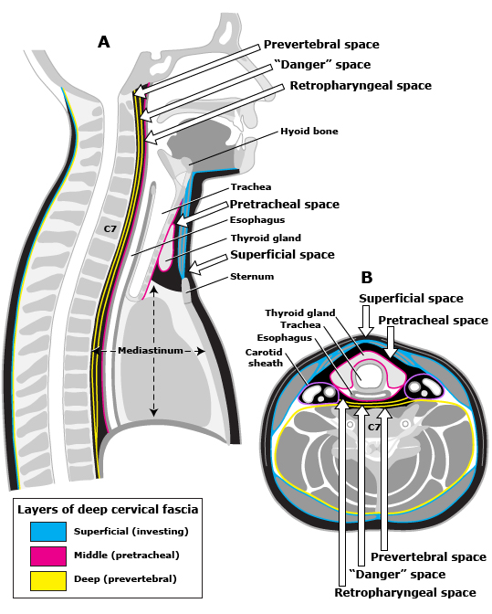

Slide 18
The Danger Space
Behind retropharyngeal space lies a space that descends directly into the mediastinum
Retropharyngeal infections can quickly spread down by gravity
Necrotizing mediastinitis
Empyema
Tamponade

Slide 19
Retropharyngeal Infections
Is it cellulitis vs abscess
Cellulitis: no drainage, just antibiotics
Abscess: Drainage + Abx
May be difficult to determine by direct visualization, CT helpful (serial scans)
Ceftriaxone/Flagyl
Any evidence of mediastinal spread should lead to a surgical intervention

Slide 20
Case #3
70 yo male w left sided pleuritic chest pain, fever
PMHx: CHF, CAD
SpO2 88% in ER on RA
CXR: LLL consolidation/effusion
Rx Ceftriaxone/Azithro, IVF x5 days
Remains febrile, hypoxic
Repeat CXR: larger left sided effusion
What do you send the thoracentesis for?

Slide 21
Parapneumonic Effusion vs Empyema
Parapneumonic effusion represents inflammatory fluid in pleural space
Cultures negative
Often responds to antibiotics alone
Empyema represents actual infection in pleural space
Cultures positive unless on antibiotics or atypical organism
Needs drainage

Slide 22
“Do Not Let the Sun Set on Emypema”
Thoracentesis diagnostic test of choice
pH <7.2 highly suggestive
Light’s criteria
Pleural Protein/Serum protein > 0.5
Pleural LDH/Serum LDH >0.6
Cultures: positive unless on antibiotics or atypical
CT Thorax w contrast useful diagnostic test: pleural enhancement strongly suggests empyema

Slide 23
Empyema: Management
Antibiotics
Direct at Strep pneumo/Staph aureus/Anaerobes
Ceftriaxone/Flagyl
Taylor to cultures
Continue until radiographic/clinical resolution
Drainage almost always necessary
Chest tube drainage sufficient in 2/3 patients
Fibrinolytic therapy for loculated effusions
VATS/Thoracotomy

Slide 24
Case #4
50 yo female, IV drug user
To ER with fever, severe back pain x 5 days
No numbness, weakness, bowel/bladder dysfunction
III/VI Systolic Ejection Murmur
MRI Spine Done:

Slide 25
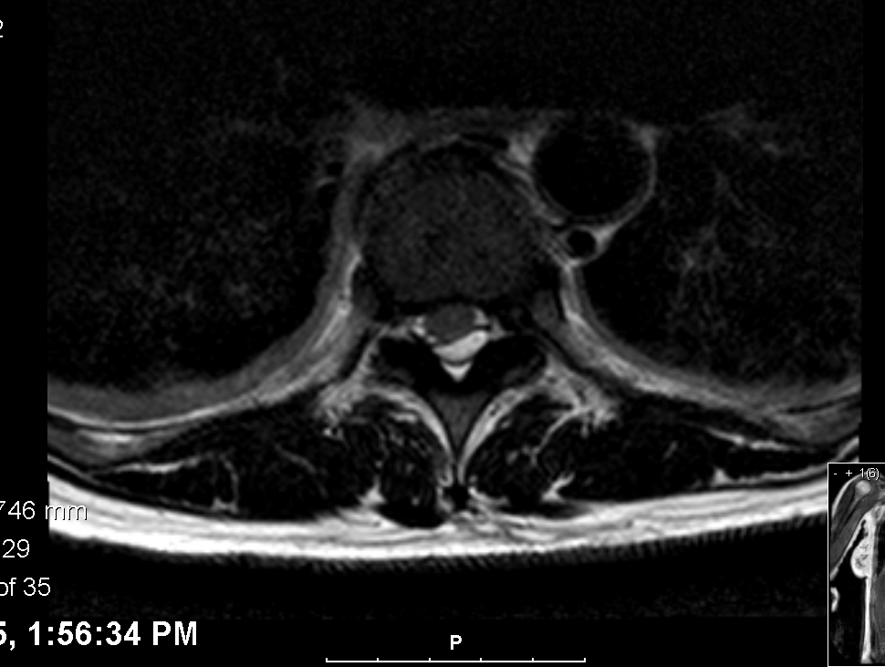
Case #4

Slide 26
Case #4
MRI Spine: Extensive epidural abscess C5-L2, mild cord compression but no cord enhancement
Does this patient need urgent surgical decompression?

Slide 27
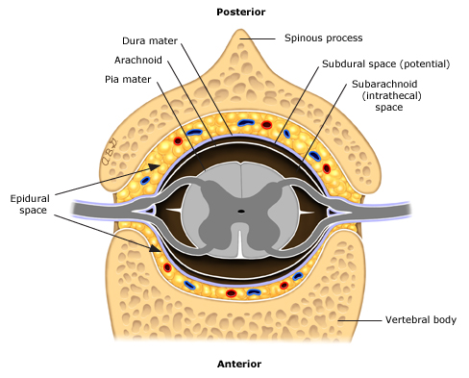
Spinal Epidural Abscess

Slide 28
Spinal Epidural Abscess
Most often begins as discitis at focal level
Once infection spreads to epidural space can spread longitudinally
>50% caused by Staph aureus
GNB, Strep, anaerobes
Ceftriaxone +/- Vanco +/- Flagyl
MRI test of choice
Better for soft tissues and spinal cord

Slide 29
Spinal Epidural Abscess: Surgical Indications
Neurological exam is key
Numbness/Weakness?
Bowel/Bladder dysfunction?
Neurologic dysfunction (myelopathy) is main indication for emergent decompression
Pain alone not an indication
If paralysis >36-72h, surgery unlikely to be of benefit

Slide 30
Case #5
60 yo male prolonged ICU stay for pancreatitis
Now on TPN
Fever- Blood cultures positive for Candida albicans x 1
Started on Fluconazole, central line D/Ced
Repeat blood cultures negative, fever resolved
Any other investigations that need to be done?

Slide 31
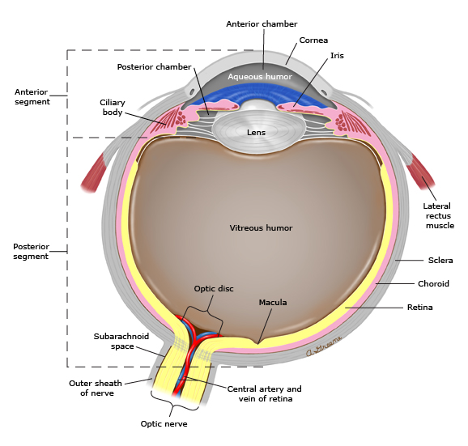
Candida Endopthalmitis
Vitritis
Chorioretinitis

Slide 32
Candida Endopthalmitis
~10% of patients with candidemia will have ocular involvement
Some may be asymptomatic
Antifungals do not penetrate well into vitreous chamber
Every patient with candidemia should have a dilated fundoscopic exam
Chorioretinitis: systemic antifungals
Vitritis: systemic antifungals + intravitreal antifungals +/- vitrectomy

Slide 33
Case #6
50 yo male admitted with fever, myalgias
Blood cultures 6/6 positive MSSA
TEE: 1.2 cm veg on AV, severe AR
Started on IV Cloxacillin
Progressive SOB, hypoxia
CXR: Pulmonary Edema
What are the surgical indications for infective endocarditis?

Slide 34
Infective Endocarditis
Classify based on organism, most important prognostic factor
Eg MSSA AV IE
Also need to consider
Native vs Prosthetic valve
Right vs Left sided
Diagnosis based primarily on
Multiple positive blood cultures over time
Vegetation on echocardiogram
Antibiotics cornerstone of therapy +/- surgery

Slide 35
Surgical Indications for IE
Antimicrobial failure
+ Blood Cx >1 week on therapy
Significant valvular dysfunction leading to CHF
More than one serious emoblic episode
Pathogen resistant to antimicrobials
Eg. All fungi
Local suppurative complications (abscess)
Vegatation >1 cm

Slide 36
RCT of surgery within 48h vs standard care
Patients with left sided endocarditis, severe valvular dysfunction and vegetation >1 cm
Pts excluded if already had indication for urgent surgery or large ischemic/hemorrhagic stroke
Composite outcome of death, emolic event, reoccurence of IE or hospitalization for CHF

Slide 38
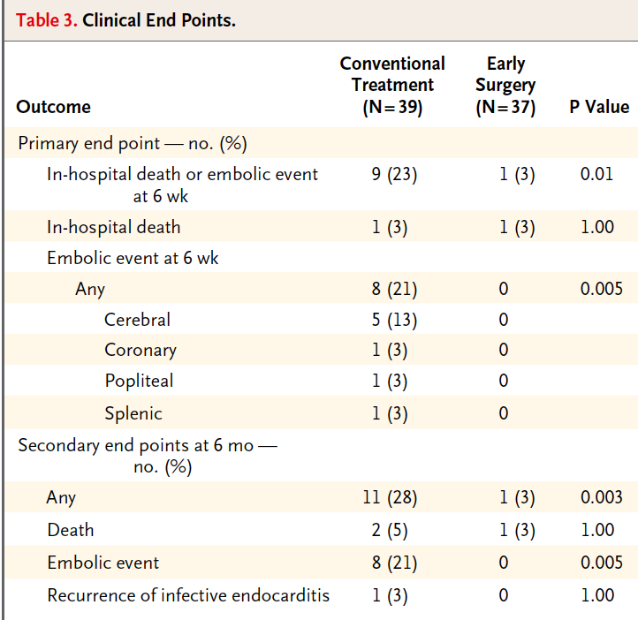

Slide 39
Case #5
While awaiting transfer for Cardiac Surgery assessment, patient develops slurred speech and right sided weakness
CT Head shows new left hemispheric septic emboli
Can this patient still go for surgery?

Slide 40
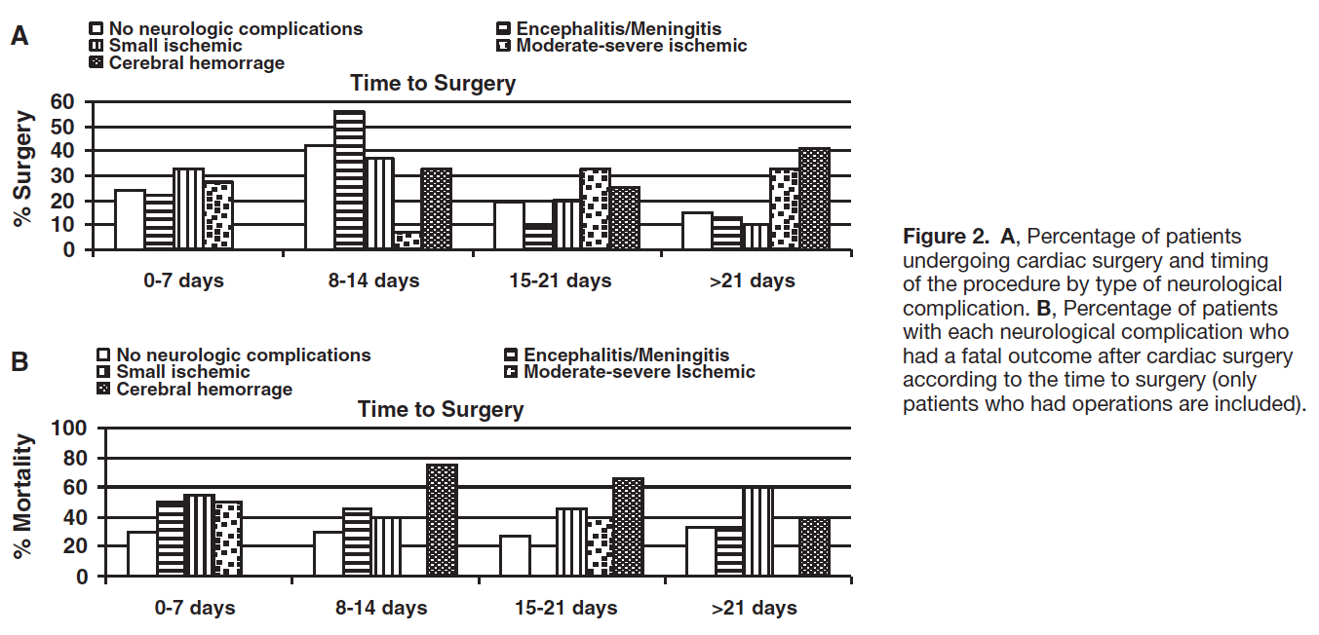

Slide 41
Timing of Cardiac Surgery in IE patients with Stroke
Mild ischemic stroke: no delay needed
TIA or <30% of one brain lobe
Mod-Severe ischemic stroke: >2 weeks
Hemorrhagic stroke: >4 weeks

Slide 42
Summary
Necrotizing Fasciitis
Pain out of keeping of exam and systemic toxicity
Do not delay a surgical diagnosis
Deep Neck Space Infections
Retropharyngeal abscesses can be life threatening due to spread through ‘danger space’
Empyema
Diagnosis depends on pleural fluid analysis
pH, LDH, Protein, Cultures
Drainage

Slide 43
Summary
Spinal Epidural Abscess
Neurological compromise is primary surgical indication
Candida endophalmitis
Every patient with Candidemia needs fundoscopy
Vitritis requires local antifungals +/- vitrectomy
Infective endocarditis
Two main surgical indications
Antibiotic failure, CHF secondary to valvular disease
Early surgery better
Delay only in severe stroke cases

Slide 44
Resources
Infectious Diseases Society of America Guidelines www.idsociety.org
Mandell Principles and Practices of Infectious Diseases 7th edition
Uptodate

