Slide 1
Surgery Resident Half-Day: Infectious Diseases
January 13 2015
Dr. Jennie Johnstone
Infectious Disease Physician, St. Joseph’s Health Center
IPAC Physician, Public Health Ontario

Slide 2
Overview
Approach to post-operative fever
Common post-operative nosocomial infections
Surgical Site Infections
Clostridium difficile
Ventilator associated pneumonia (VAP)
Hand hygiene

Slide 3
Approach to post-operative fever
Fever
Early
(<1 week)
Subacute
(1-4 weeks)
Delayed
(>4 weeks)
Infectious
Non-infectious
Infectious
Non-infectious
Infectious
Non-infectious

Slide 4
Acute Infections <1 week
Community acquired infections
Nosocomial infections
Pneumonia
Ventilator associated pneumonia
Hospital associated pneumonia
Aspiration pneumonia/pneumonitis
Urinary tract infection
Surgical site infections
Central line infections
Non-infectious conditions
Cytokine release due to surgery
Pancreatitis
MI
DVT/PE
Thrombophlebitis
Withdrawal
Gout

Slide 5
Subacute Infections
Nosocomial infections
Surgical site infections
C. difficile
Central line infections
VAP/HAP
UTIs
Non-infectious causes
Drug reactions
DVT/PE

Slide 6
Delayed Infections
Almost always infectious
Surgical site infections due to more indolent organisms
E.g. coagulase negative staphylococcus prosthetic joint infection
Infective endocarditis
Infections unrelated to the surgery

Slide 7
Atelectasis
No association between fever and presence of atelectasis
Likely coincidental not causal.
Engoren M Chest 1995; 107: 81

Slide 8
Surgical Site Infections (SSI)

Slide 9
Case
68 year old M with known DM and CAD
Requires CABG
Does well post-operatively
To the ward, but after several days complains of increasing pain in the sternum
Notable cellulitis around lower incision site and drainage from lower aspect of wound

Slide 10
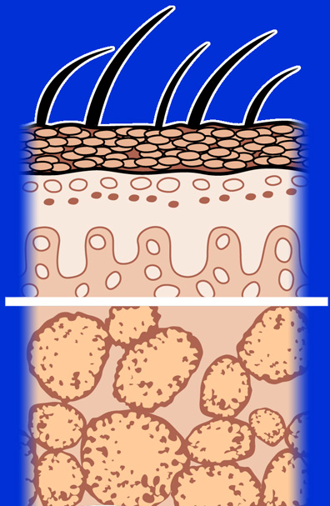
Superficial Incisional SSI
Infection occurs within 30 days after the operation and involves only skin or subcutaneous tissue of the incision
Skin
Superficial incisional SSI
Subcutaneous tissue
Mangram AJ et al. Infect Control Hosp Epidemiol. 1999;20:250-278.
Notes:
The first type of surgical site infection is the superficial incisional surgical infection which occurs within 30 days post-op and involves only the skin or subcutaneous tissue.

Slide 11
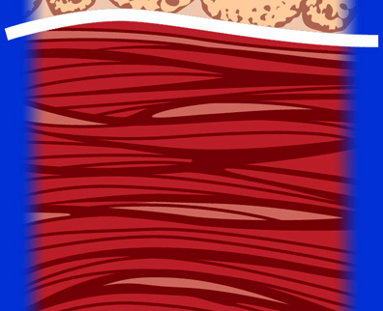
Deep Incisional SSI
Infection occurs within 30 days after the operation if no implant is left in place or within 1 year if implant is in place and the infection appears to be related to the operation and the infection involves the deep soft tissue (e.g., fascia and muscle layers)
Superficial incisional SSI
Deep soft tissue (fascia & muscle)
Deep incisional SSI
Mangram AJ et al. Infect Control Hosp Epidemiol. 1999;20:250-278.
Notes:
A more serious SSI is a deep incisional surgical infection, which extends past the superficial layer. The infection occurs within 30 days post-op only if no implant is left in place or within 1 year if implant is in place and the infection appears to be related to the operation and the infection involves the deep soft tissue, which include the fascia and muscle layers.

Slide 12
Organ/Space SSI
Infection occurs within 30 days after the operation if no implant is left in place or within 1 year if implant is in place and the infection appears to be related to the operation and the infection involves any part of the anatomy, other than the incision, which was opened or manipulated during the operation
Superficial incisional SSI
Deep incisional SSI
Organ/space
Organ/space SSI
Mangram AJ et al. Infect Control Hosp Epidemiol. 1999;20:250-278.
Notes:
The most extensive of these surgical infections involves the organs and the space surrounding the organs. These infections can occur within 30 days post-op if no implant is left in place or within 1 year if an implant is in place and the infection appears to be related to the operation and the infection involves any part of the anatomy, other than the incision, which was opened or manipulated during the operation.

Slide 13
Burden of Disease Due to SSIs (1)
Burden-US
~300,000 SSIs/yr (17% of all HAI; second to UTI)
2%-5% of patients undergoing inpatient surgery
Rates associated with size and acuity of hospitals
Clean vs. dirty wound
Type of surgery
Abdominal > colon > gastric > pancreas/liver > exploratory laparotomy > appendectomy
Mortality
3 % mortality
2-11 times higher risk of death
75% of deaths among patients with SSI are directly attributable to SSI
Morbidity
long-term disabilities
Anderson DJ. Infect Control Hosp Epidemiol 2008;29:S51-S61

Slide 14
Burden of Disease Due to SSIs (2)
Length of Hospital Stay
~7-10 additional postoperative hospital days
Cost
$3000-$29,000/SSI depending on procedure & pathogen
Up to $10 billion annually (US)
Anderson D et al. Infect Control Hosp Epidemiol 2008;29:S51-S61

Slide 15
Risk Factors: Operation Factors
Duration of surgical scrub
Maintain body temp
Skin antisepsis
Preoperative shaving
Duration of operation
Antimicrobial prophylaxis
Operating room ventilation
Inadequate sterilization of instruments
Foreign material at surgical site
Surgical drains
Surgical technique
Poor hemostasis
Failure to obliterate dead space
Tissue trauma
Mangram AJ et al. Infect Control Hosp Epidemiol. 1999;20:250-278.
Notes:
Both operation factors and patient characteristics may influence the risk of surgical site infection.
Depending on the conditions of the operation a patient can be at an even greater risk of infection. These factors can include duration of surgical scrub, maintenance of body temperature, the use of skin antisepsis, preoperative shaving, duration of the operation, antimicrobial prophylaxis, ventilation of the operating room, inadequate sterilization of instruments, the presence of foreign material at the surgical site, surgical drains, and surgical technique. Poor surgical technique includes poor hemostasis, failure to obliterate dead space, and tissue trauma.

Slide 16
Risk Factors: Patient Characteristics
Age
Diabetes
Nicotine use: delays primary wound healing
Steroid use: controversial
Malnutrition: no epidemiological association
Obesity: 20% over ideal body weight
Prolonged preoperative stay: surrogate of the severity of illness and comorbid conditions
Preoperative nares colonization with Staphylococcus aureus: significant association
Perioperative transfusion: controversial
Coexistent infections at a remote body site
Altered immune response
Mangram AJ et al. Infect Control Hosp Epidemiol. 1999;20:250-278.
Notes:
This slide shows risk factors for patients who are considered to be at a higher risk for surgical site infection.
High-risk characteristics include advanced age, diabetes, smoking, poor nutritional status, obesity, coexisting infections at a particular body site, and altered immune response, among other factors.
Prolonged preoperative stay is also a risk, depending on the severity of illness and comorbid conditions. There is also a significant association between preoperative nares colonization with Staphylococcus aureus and surgical site infection. Perioperative transfusion remains a controversial issue.

Slide 17
Pathogenesis
Endogenous
Patient flora
Skin
Mucous membranes
GI tract
Seeding from a distant focus of infection

Slide 18
Pathogenesis
Exogenous
Surgical Personnel (surgeon and team)
Soiled attire
Breaks in aseptic technique
Inadequate hand hygiene
OR physical environment and ventilation
Tools, equipment, materials brought to the operative field

Slide 19
Organisms Causing SSI
Staphylococcus aureus 30.0%
Coagulase-negative staphylococci 13.7%
Enterococcus spp. 11.2%
Escherichia coli 9.6%
Pseudomonas aeruginosa 5.6%
Enterobacter spp 4.2%
Klebsiella pneumoniae 3.0%
Candida spp. 2.0%
Klebsiella oxytoca 0.7%
Acinetobacter baumannii 0.6%
N=7,025
Hidron AI, et.al., Infect Control Hosp Epidemiol 2008;29:996-1011

Slide 20
Clinical Manifestations
Localized erythema
Induration
Warmth
Pain at incision site
Purulent wound drainage and separation of wound can occur
May be associated with fever and leukocytosis

Slide 21
Treatment
Surgical:
Suture removal
Explored
Drained
Irrigated
Dressed open
Antibiotics:
Not routinely needed
Use when there is:
Presence of cellulitis >5 cm from wound edge
Systemically unwell (temperature >38.5°C, HR >110bpm, or WBC > 12)
Progressing despite drainage
IDSA Guidelines 2014

Slide 22
Choice of Antibiotics
Obtain swabs cultures if possible
If empiric antibiotics are required:
For most surgeries, 1st generation cephalosporin/anti-staph penicillin for MSSA or vancomycin or linezolid if MRSA is suspected or confirmed
For SSI post surgery on axilla, GI tract, perineum or female genital tract, agents with GNB and anaerobes are recommended (e.g. cephalosporin/fluoroquinolone +metronidazole)
Tailor antibiotics according to cultures and response
Duration will depend on depth, completeness of drainage and response
Uncomplicated: 7 days should be sufficient (PO)
Involving bone: 6 weeks IV antibiotics
IDSA Guidelines 2014

Slide 23
Clostridium Difficile

Slide 24
Case
80 year old F admitted from home with hip # after a fall
ORIF complicated by post-operative delerium due to pain medications
Slow recovery, transferred to in-patient rehabilitation
Two weeks post-operatively developed 5 non-bloody BMs in one day, associated with decreased appetite, fatigue
Labs showed WBC of 14, slight elevation of Cr, otherwise normal
Stool sent for C. difficile: PCR positive

Slide 25
Burden of Disease
Dramatic increases in the incidence and severity of nosocomial C. difficile associated diarrhea in Canada
Due to the emergence of NAP1 strain
Appears more virulent than other strains
During the Quebec outbreak of NAP1 C. difficile in 2003:
10% required ICU admission
2.5% underwent emergency colectomy
16% died
Is a patient safety indicator in many jurisdictions
Pepin et al CMAJ 2005; 173: 1037

Slide 26
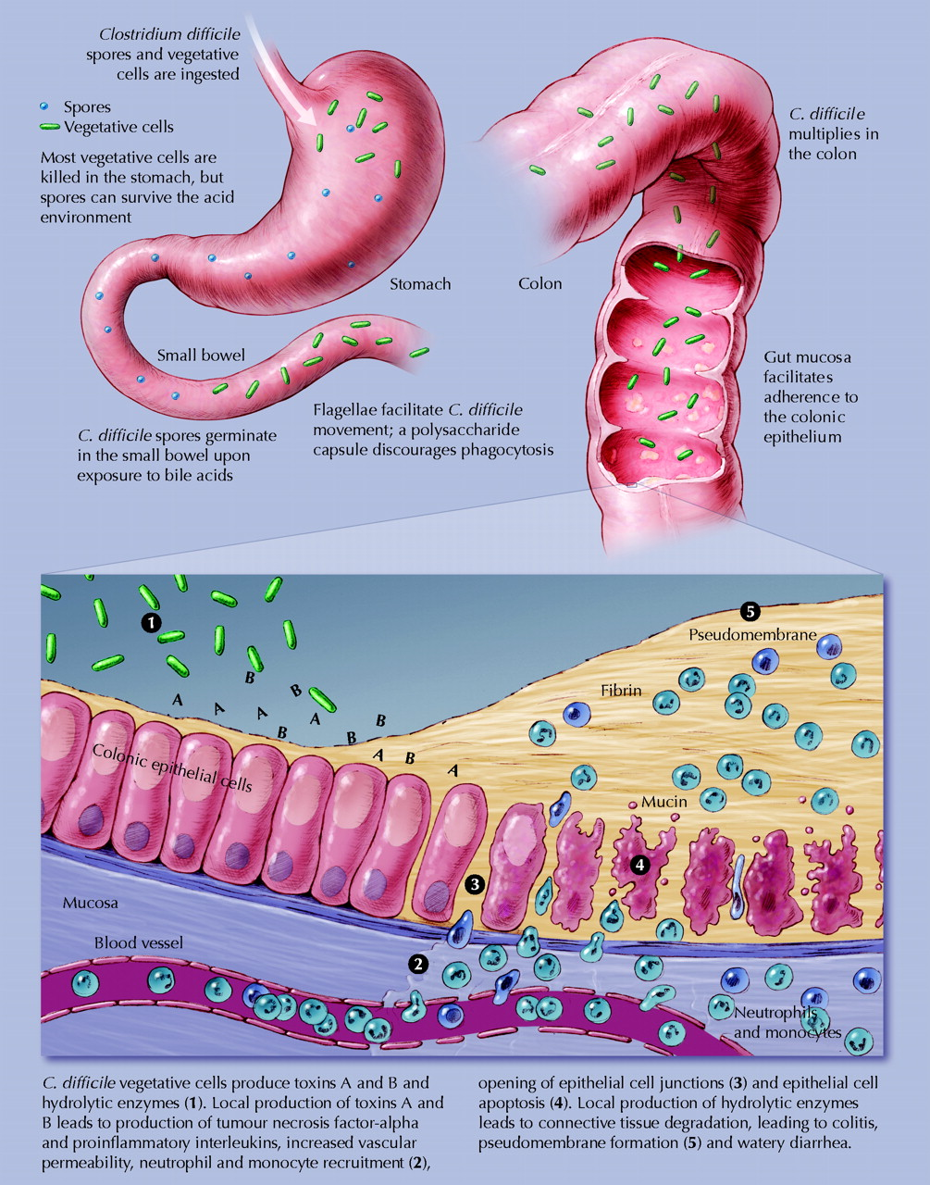
Pathogenesis
Asymptomatic carriage of C. difficile in healthy adults is ~3%
Proportion increases to >20% among hospitalized adults
Many acquire spores in the hospital setting
Poutanen S CMAJ 2004; 171: 51-58

Slide 27
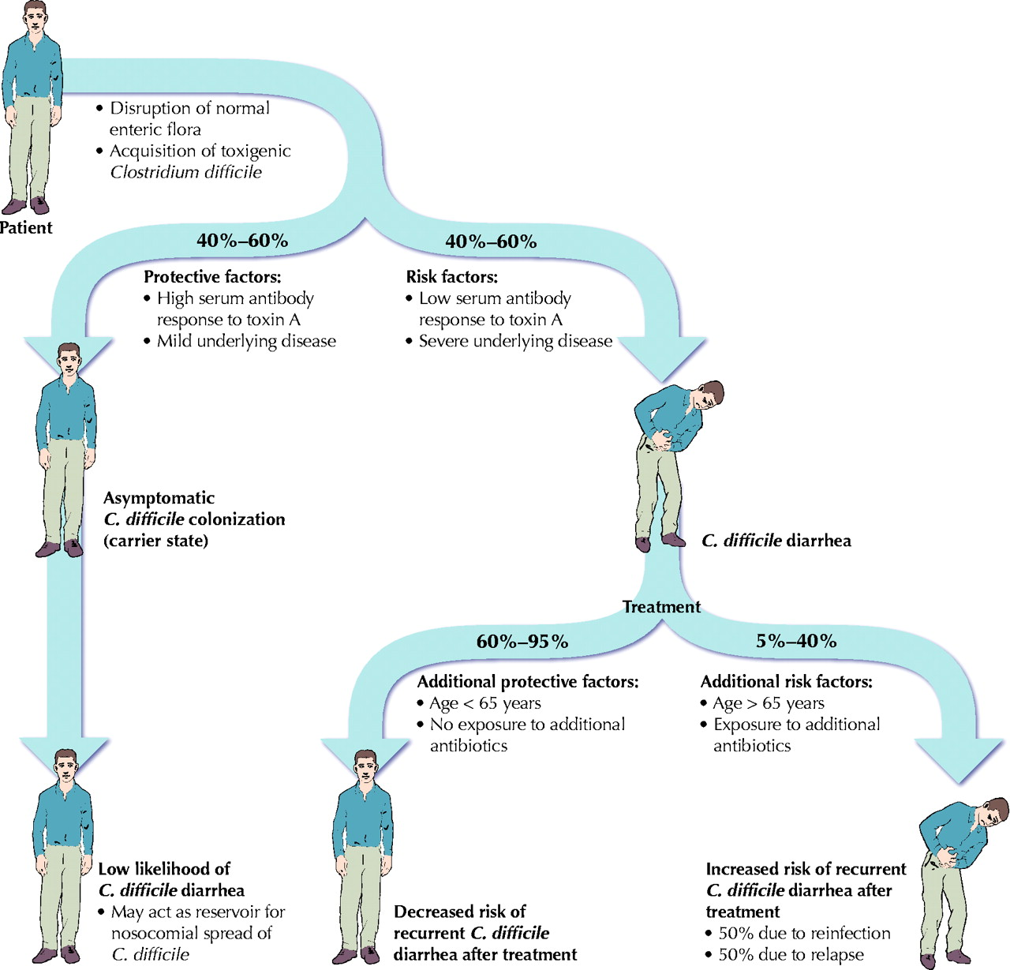
Risk Factors
Antibiotic use (esp. clindamycin use, fluoroquinolones and cephalosporins)
Hospital exposure
Advanced aged
Co-morbid illness
Gastric acid suppression
Enteral feeding
Gastrointestinal surgery
Obesity
Cancer chemotherapy
Poutanen S CMAJ 2004; 171: 51-58

Slide 28
Clinical Presentation
Carrier state
Diarrhea with colitis:
Watery diarrhea
Lower abdominal pain and cramping
Low grade fever and leukocytosis
Fulminant colitis with toxic megacolon (1-3%):
Colonic dilatation (>7cm)
Severe systemic toxicity
Bowel perforation
Poutanen S CMAJ 2004; 171: 51-58
5-40% will go on to develop recurrent disease
Mortality 24-38%

Slide 29
Differential Diagnosis
Laxative use
Enteral feeds
Underlying disease (i.e. IBD)
Medications
Other causes of diarrhea

Slide 30
Diagnosis
PCR assays: real-time PCR that detect toxin A and B genes
EIA for C. difficile toxins
Colonoscopy
High sensitivity, high specificity
Lower sensitivity, high specificity

Slide 31
Treatment
Cessation of inciting antibiotics where possible
Supportive care
Avoid anti-motility agents
Discontinue laxatives
Non-severe disease
Metronidazole 500 mg PO QID x 14 days
Vancomycin 125mg PO QID x 14 days
IDSA Guidelines 2010
Zar et al Clin Infect Dis 2007; 45: 302-307

Slide 32
Treatment
Severe disease (WBC ≥15 and Cr >1.5 baseline)
Vancomycin 125 mg PO QID
+/- metronidazole 500mg IV TID
Consider surgical consult if:
Evidence of peritonitis or
Toxic megacolon or
No improvement within 48 hours

Slide 33
Novel Approaches
Fidaxomicin
RCT showed that fidaxomicin was non-inferior to vancomycin for clinical resolution
Reduced recurrence (13% vs. 24% for vancomycin)
Louie et al NEJM 2011; 364: 422 - 431
Stool ‘transplants’
RCT comparing duodenal infusion of donor feces with vancomycin showed better outcomes with donor feces (81% resolution versus 31% with vancomycin)
Van Nood et al NEJM 2013; 368: 407-415
Probiotics
Unclear benefit
Allen et al Lancet 2013; 382: 1249-1257

Slide 34
VentilatOR Associated pneumonia (VAP)

Slide 35
Case
Post-op open thoracotomy for removal of a lung mass in LUL in a 75 M with longstanding history of smoking
Difficulty weaning pt from ventilator
After 4 days in ICU, develops fever, elevated WBC and new infiltrate
ID consulted, VAP diagnosed

Slide 36
Burden of Disease due to VAP
Incidence of VAP (>48 hours of intubation):
51 RCTs – 23%
38 cohort studies
Med-surg – 9%
Medical ICUs – 17%
Mortality of VAP: OR 2
LOS due to VAP: 6 additional days
Cost due to VAP: ~$10,000 per episode
Safdar N et al Crit Care Med 2005; 33:2184 - 2193

Slide 37
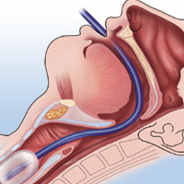
Pathogenesis
Colonization of oropharynx with pathogens
Microaspiration of pathogens into lower airways
Inability of host to clear pathogens from lung
VAP
2005 ATS/IDSA VAP Guidelines
Notes:
Hospitalized patients become colonized with microorganisms acquired from the hospital environment within 48 hours
When ventilated – facilitated by respiratory devices and contaminated water reservoirs.

Slide 38
Clinical Presentation
Patients receiving mechanical ventilation
New or progressive infiltrate
Fever
Leukocytosis
Purulent tracheobronchial secretions
Increased respiratory rate
Increased minute ventilation
Decreased tidal volume
Decreased oxygenation
Need for more ventilator support or more FiO₂

Slide 39
Differential Diagnosis
Aspiration pneumonitis
Atelectasis
PE
ARDS
Pulmonary hemorrhage
Lung contusion
Infiltrative tumor
Radiation pneumonitis
Drug reaction
BOOP

Slide 40
Diagnosis
Diagnosis is challenging
Generally suspected when there is:
New infiltrate on CXR plus
Two or more symptoms or signs of respiratory infection
No alternate explanation
Role of invasive vs non-invasive techniques
If empiric therapy for VAP to be initiated, ETT specimen with non-quantitative culture acceptable as initial dx test
Muscedere J Critical Care 2008; 23: 138-147
Comprehensive Evidence Based CPGs

Slide 41
Potential Diagnostic Tests
Imaging
All patients with suspected VAP should have CXR
Microbiology
All patients suspected of VAP should have micro sent
Varies from ETT to BAL
Procalcitonin
Promising biological marker, has been used in CAP
May instead have a role in d/c abx or prognosis

Slide 42
Therapy
Empiric therapy is recommended when there is a clinical suspicion of VAP
No role for combination therapy (for synergy purposes)
Appropriate single agent therapy for each potential pathogen
Muscedere J Critical Care 2008; 23: 138-147
Comprehensive Evidence Based CPGs

Slide 43
The Pathogens
Pathogen | Prevalence | Mortality
MRSA | 15% | 32%
Pseudomonas | 14% | 29%
Other Staph | 9% | 23%
Klebsiella | 3% | 23%
Enterobacter | 3% | 8%
E. coli | 3% | 25%
Acinetobacter | 2% | 50%
No sig org ID | 37% | 20%
No investigations | 13% | 36%
Kollef Chest 2006

Slide 44
Antibiotic Selection
There have been at least 11 antibiotic regimens for treatment of VAP
No regimen is superior
Further study is needed before linezolid can be considered superior to vancomycin
Antibiotic treatment of VAP should be based on the local resistance patters and patient factors
Wunderlink Chest 2003; 124: 1789
Muscedere J Critical Care 2008; 23: 138-147
Comprehensive Evidence Based CPGs

Slide 45
Potential Options
Potential Pathogens | Antibiotic Therapy
 | Antipseudomonal cephalosporin
Pseudomonas aeruginosa | or
Klebsiella pneumoniae (ESBL) | Antipseudomonal carbepenem
Acinetobacter species* | or
MSSA | ß-Lactam/ß-lactamase inhibitor
 | plus
Legionella pneumophila | Antipseudomonal fluoroquinolone
 | or
 | Macrolide
 | plus
Methicillin-resistant Staphylococcus aureus (MRSA) | Linezolid or vancomycin
From ATS/IDSA 2005 Guidelines

Slide 46
Duration
Prospective RCT of 401 patients with VAP
8 days vs. 15 days
All treated with anti-pseudomonal beta-lactam plus either an aminoglycoside or fluorquinolone
No difference in mortality or recurrent infection at 28 days
In the presence of pseudomonas/acinetobacter, use clinical judgment
Chastre JAMA 2003; 290: 2588-2598

Slide 47
De-escalation of therapy
If patient with suspected VAP started on abx and no improvement and cultures negative, look for alternative diagnosis
Consider discontinuation of therapy
If pathogen isolated, can narrow abx
ATS/IDSA 2005 VAP Guidelines

Slide 48
Hand Hygiene

Slide 49
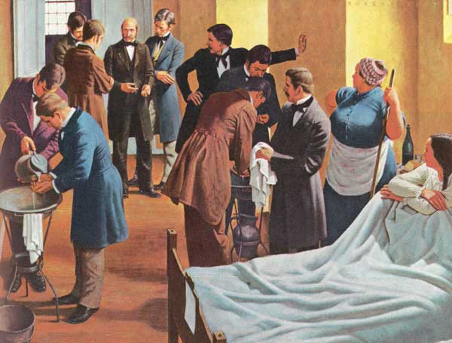
www.cdc.gov

Slide 50
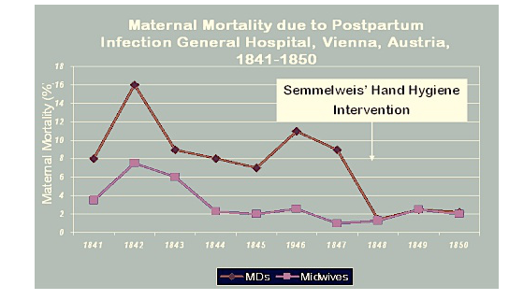

Slide 51
Healthcare Acquired Infections
Healthcare acquired infections (HAI’s)
Antibiotic resistant organism infections
Surgical site infections
C. difficile infections
5-10% of all patients will acquire an HAI, translates to 8000 deaths each year in hospitals in Canada
Hand hygiene helps reduce infections
8 observational studies showing reduction in AROs or HAIs
10 RCTs in community setting showing reduction in respiratory or diarrheal illness

Slide 52
Two Different Environments
Patient
Health care
Patient
Health Care
Environment
Environment
Environment
Environment
This is the patient
This is the patient
’
’
s area. In
Environment beyond the
s area. In
Environment beyond the
a single room this is
patient
a single room this is
patient
’
’
s immediate area. In
s immediate area. In
everything in the patient
everything in the patient
’
’
s
a single room this is outside
s
a single room this is outside
room. In a multiple room
the room. In a multiple room
room. In a multiple room
the room. In a multiple room
this is everything in
this is everything outside of
this is everything in
this is everything outside of
immediate proximity to the
the patient
immediate proximity to the
the patient
’
’
s bed area.
s bed area.
patient.
patient.

Slide 53
Your 4 Moments for Hand Hygiene

Slide 54
Moment 1
Some examples:
shaking hands, stroking an arm
helping a patient to move around, get washed
taking pulse, blood pressure, chest auscultation, abdominal palpation
before adjusting an IV rate

Slide 55
Moment 2
Some examples:
skin lesion care, wound dressing, subcutaneous injection
catheter insertion, opening a vascular access system or a draining system
preparation of medication, dressing sets

Slide 56
Moment 3
Some examples:
skin lesion care, wound dressing, subcutaneous injection
drawing and manipulating any fluid sample, opening a draining system, endotracheal tube insertion and removal
clearing up urine, faeces, vomit, handling waste (bandages, napkin, incontinence pads), cleaning of contaminated and visibly soiled material or areas (bathroom, medical instruments)

Slide 57
Moment 4
Some examples:
shaking hands, stroking an arm
taking pulse, blood pressure, chest auscultation, abdominal palpation
changing bed linen
perfusion speed adjustment
monitoring alarm
holding a bed rail
clearing the bedside table

Slide 58
Hand Hygiene and Glove Use
The use of gloves does not replace the need to clean hands
Discard gloves after each procedure and clean your hands
Wear gloves only when indicated, otherwise they become a major risk for transmission of organisms

Slide 59
Hand Hygiene Compliance at SJHC
One of the key Provincial patient safety indicators
Publically reported on the Health Quality Ontario website
Went from >90% to ~50% in 2013/2014.... what happened?

Slide 60
Hand Hygiene Auditing Methodology
Before:
Self-audits
No training
Results inconsistent with infection control/TPH audits
Presence of auditor known
Subjective
Now:
Independent audits
Receive 4-5 hours of training
Inter-rater reliability testing
Presence generally not noticed
Objective
We do at least 30 audits per unit per month

Slide 61
Hand Hygiene Adherence at SJHC
Moment | Compliance 2014-2015 Q1 | Compliance 2014-2015 Q2 | Compliance 2014-2015 Q3
Moment #1 (Before patient/patient environment) | 225/594 (38%) | 247/559 (44%) | 159/267 (60%)
Moment #4 (After patient/patient environment) | 657/1101 (60%) | 645/1018 (63%) | 434/610 (71%)
Moment #1 and #4 | 882/1695 (52%) | 892/1577 (57%) | 593/877 (68%)

Slide 62
Physician/Surgeon Hand Hygiene Compliance
Moment | Compliance 2014-2015 Q1 | Compliance 2014-2015 Q2 | Compliance 2014-2015 Q3
Moment #1 (Before patient/patient environment) | 25/57 (44%) | 32/50 (64%) | 11/14 (79%)
Moment #4 (After patient/patient environment) | 49/85 (58%) | 56/88 (64%) | 20/34 (59%)
Moment #1 and #4 | 75/142 (52%) | 88/138 (64%) | 31/48 (65%)

Slide 63
What are the Barriers?
Workload realities (i.e. urgent care/interruptions)
Guidelines thought to be overly conservative
Gaps in knowledge
Self protection as primary driver for hand hygiene
Limited access to hand hygiene product
HCWs perceive physicians as role models
Physicians do not see themselves as such
Jiang, et al. Infect Control Hosp Epidemiol 2010; 31: 144

Slide 64
How to Improve?
Cochrane systematic review:
4 included studies
Interventions included:
Substitution of product
Different multi-faceted interventions
Concluded that we lack sufficient evidence to know which strategies improve hand hygiene compliance
Gould et al. Cochrane Review 2010; 9: CD005186

Slide 65
Behavior Change Theory
Front Line Ownership (FLO):
Involves having people who do the work develop ideas for design and implementation of solutions
Grassroots and ‘ownership’ of the problem will be more successful than top down approaches
Zimmerman, et al. Healthcare Papers 2013; 13: 6

Slide 66
If we Improve MDs we will improve all: Plan Moving Forward
Education
Awareness
Feedback re: physician/surgeon hand hygiene rates
Promote conversation
Improve access to hand sanitizer
Positive feedback
Front line ownership:
Physician champions

Slide 67
Conclusions
When approaching post-op fever, consider timing of fever and infectious and non-infectious causes
Nosocomial infections are common and have associated morbidity and mortality
Most nosocomial infections are preventable
Hand hygiene is one of the most effective ways to reduce nosocomial infections

