Slide 1
Multimodality Therapy of Cancer:
Solid Tumour Treatment is a Team Sport!
Principles of Surgery 2011
Andy Smith, MD
Department of Surgery
University of Toronto

Slide 2


Slide 3
Overview
Don’t just whack it out!
Optimal care requires multiple disciplines
How do we accomplish multidisciplinary care in Ontario?

Slide 4
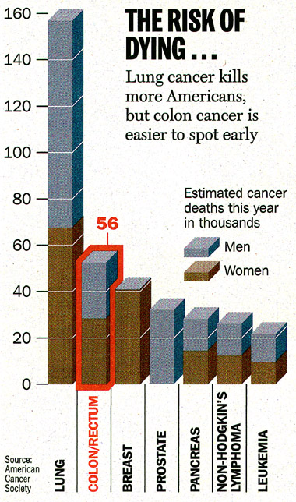
Colorectal Cancer
#2 cancer killer in Canada
Nearly all CRC patients see a surgeon
  4/5 patients present with “curable” disease
  1/3 will develop metastatic disease
Optimal care happens only when there is coordinated involvement of multiple professionals
  including radiology

Slide 5
How does rectal cancer attack?
Longitudinal growth
Circumferential growth
Focus on the “tube” and the surrounding “fat packet” (mesorectum)
Suboptimal management can happen in or out of the OR

Slide 6
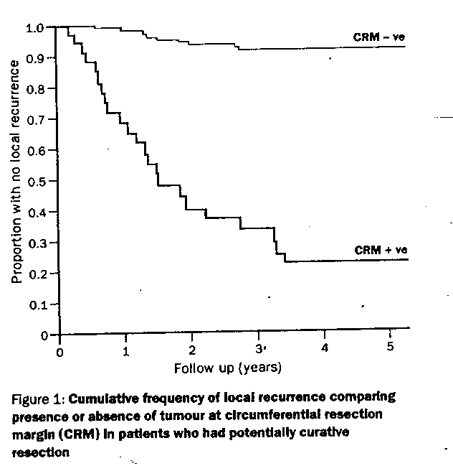
Rectal Cancer Cure Requires…..
R0
Adam et al
Role of circumferential margin involvement in
local recurrence of rectal cancer.
Lancet 1994; 344:707-11

Slide 7

How do we get R0?
Accurate staging (MRI, ERUS)
Appropriate application of preoperative chemotherapy and radiotherapy
Precision surgery
  Sharp anatomic dissection
Assessment of the quality of the excision and patient outcomes
  Pathological audit and feedback
  Oncologic & Functional outcomes

Slide 8

Pre-operative Staging and Treatment Planning
The radiologist

Slide 9
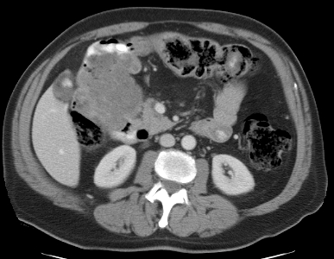
Is the tumour locally advanced?
There is a large mass measuring 8.7 x 7.2 cm, which invades the hepatic flexure, the pylorus, and the first and second portions of the duodenum. The epicenter appears to be the colon. There is no sign of bowel or gastric obstruction. There are small lymph nodes in the mesentery adjacent to the ascending colon measuring up to 1 cm. There are multiple small mesenteric lymph nodes measuring up to 9 mm. No definite invasion of the pancreas. The mass abuts the liver at the porta and the undersurface of segment 5, no definite invasion.

Slide 10

Conundrum
This tumour is stuck to the bladder.
Can I ‘get away’ with ‘cracking the tumour off’ the adjacent organ?
It’s probably just inflammation, right?

Slide 11
Does the CRC invade the adjacent organ?
Attachment to Contiguous Organs
Inflammatory
Adhesions
Malignant
Adhesions
Malignant adhesions present in 25 - 84% of tumours
A surgeon cannot reliably tell which adhesions are malignant before resection

Slide 12
Principle of Surgery
Ideally, locally advanced adherent tumours should be diagnosed preoperatively through appropriate application of cross-sectional imaging, especially CT scanning, and should be assumed to be malignant in curative-intent operations.

Slide 13
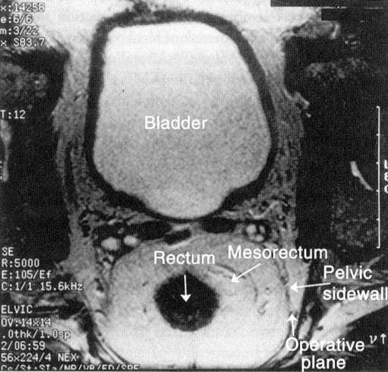
Is it a T3/T4 or node positive?
Accurate staging informs need for pre-operative treatment
CT scan gives a “sense” for extent of tumour
MRI and/or ERUS are better
CRT

Slide 14

Appropriate Preoperative Therapy
The radiation oncologist and medical oncologists

Slide 15
Case example
61M
two months history of bright red blood per rectum
digital rectal examination
  posterior midline is a firm and possibly fixed rectal cancer
  suspect this is at least a T3 tumor
  located 1 cm above the top of the sphincter muscle
  tone, squeeze and sensation are all normal

Slide 16
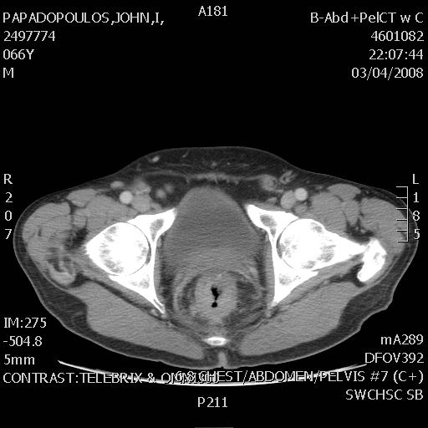
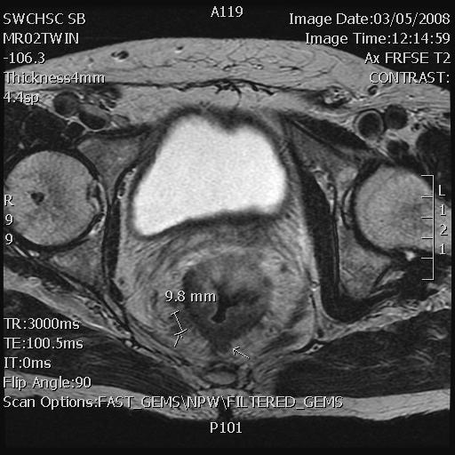
CT and MRI
2497774

Slide 17
Principle of Surgery
Consider neoadjuvant therapy
  Radiation therapy helps!
Meta-analyses on rectal cancer
  Pre-operative radiation improves local control and overall survival1,2
    +/- chemotherapy
JAMA 2000;284:1008
Lancet 2001; 358:1291

Slide 18
Key excerpt from the CCO guideline
All rectal cancers should undergo preoperative workup to assess the extent to which the CRM is threatened. This includes pelvic CT or MRI.
For lesions that are stage II (i.e., T3 or T4) or III (i.e., likely positive lymph nodes on cross sectional imaging), neoadjuvant therapy should be considered.
Such determinations demand a high-quality MRI and, ideally for T status, a trans-rectal ultrasound

Slide 19

Precision Surgery
The Surgeon

Slide 20
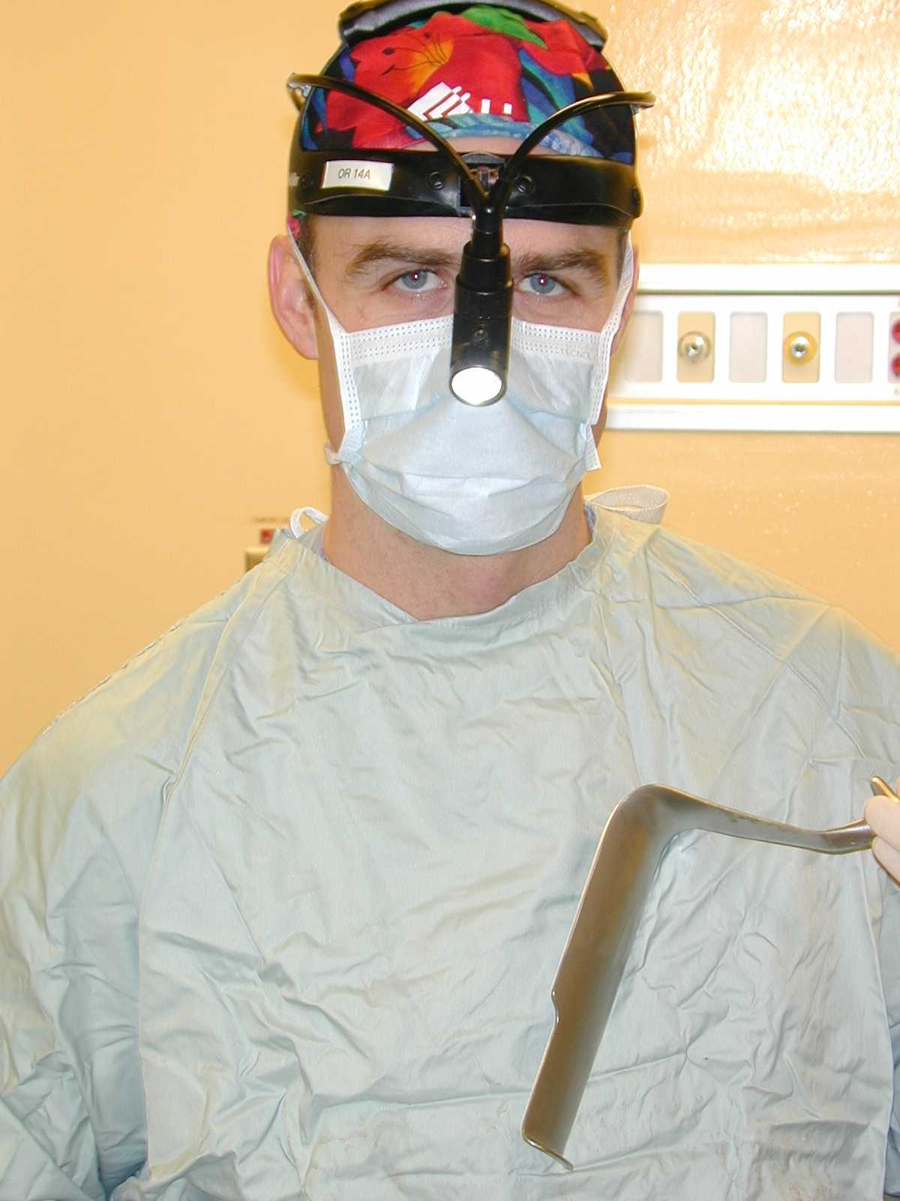
Total Mesorectal Excision (TME)
Key focus on:
  radial resection margin
  extent of distal mesorectal excision
Advantages
  lower recurrence rates
  lower stoma rates
  decreased nerve damage

Slide 21
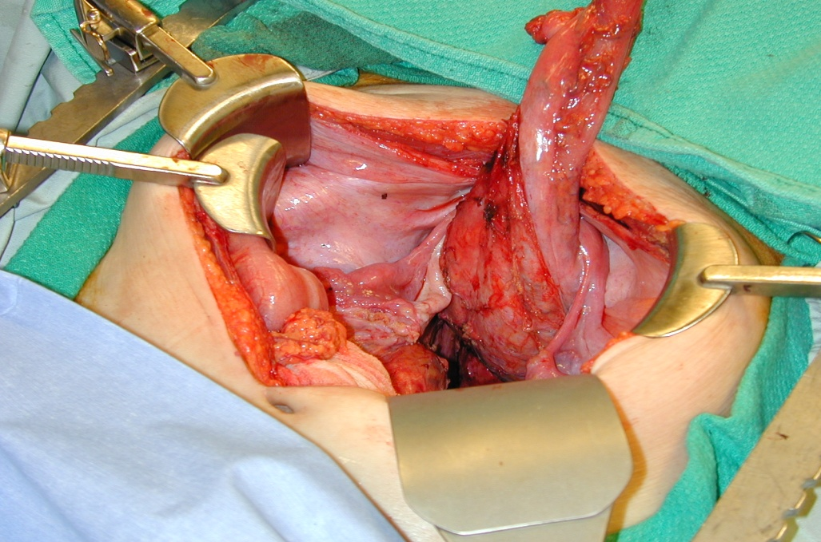
TME reduces local recurrence of
rectal cancer
TME technique impacts margin status
Reduce LR from 25-30% (blunt) to 10 to 15% (TME)1
“Single digit” rates of LR reported from large, speciality units with TME only
1. Havenga, Enker et al Eur J Surg Onc 1999

Slide 22
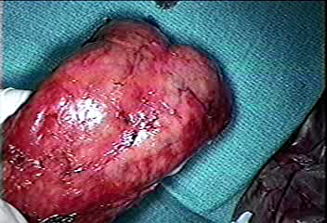
Validation of Quality Operation
Shiny Visceral Mesorectal Fascia

Slide 23
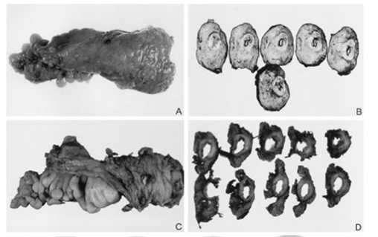
Principle of Surgery
Quality of surgery is a crucial determinant of outcome
Local recurrence = local residual = our failure…
  To achieve clear margins
  To preserve an intact mesorectum

Slide 24
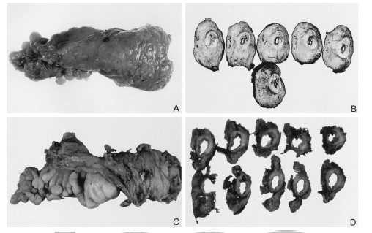
Specimen quality is related to outcome
130 pts (2001-2003) curative TME resections
Mesorectum graded:
  1. little bulk, defects down to muscularis propria
  2. moderate bulk, irregular surface, no visible muscle
  3. intact, smooth, no defect >5mm
CRM+ve in only 7%
  No relationship to LR, OR
  Associated with grade 1 mesorectum
MR grade vs Recurrence
MR grade | Total patients | Local recurrence | Overall recurrence
1 | 17 | 7(41%) | 10(59%)
2 | 52 | 3(5.7%) | 9(17%)
3 | 61 | 1(1.6%) | 1(1.6%)
p |  | 0.0001 | 0.0001
Maslekar S, et al. Dis Colon Rectum 2007;50:168-175

Slide 25

Staging and Adjuvant Therapy Decisions
Pathology and Medical Oncology

Slide 26
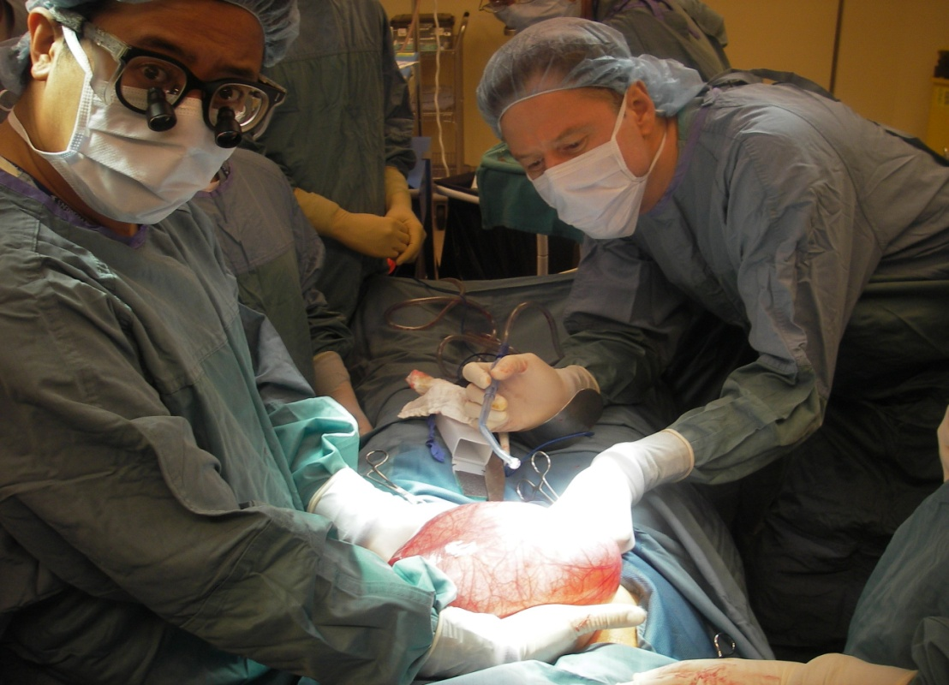
Staging CRC is important
How many lymph nodes do you need to accurately assess the nodal stage of a CRC patient (N-stage)?

Slide 27

Lymph Nodes and Treatment
single most important factor for determining benefit from post-operative adjuvant chemotherapy in colon cancer
clear benefit for “stage III” – node positive patients
no clear benefit for “stage II” – node negative patients

Slide 28

What “benefits” are we talking about?
in NODE POSITIVE patients:
  15% absolute improvement in 5 year overall survival
  30% absolute improvement in 5 year disease free survival
perspective: this represents the biggest “bang for the buck” in adjuvant chemotherapy

Slide 29
The minimum number of lymph nodes that should be assessed is:
CCO Guideline JSO 2010
12

Slide 30
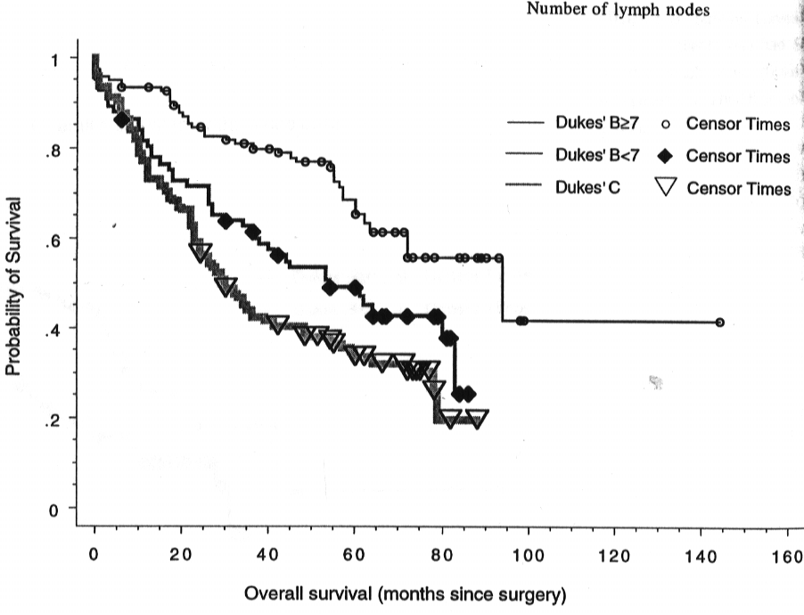
Lymph Node Assessment and Patient Survival
Caplin et al. Cancer 1998:83; 666
Law et al. J Surg Onc 2003:84;120

Slide 31
CRC Lymph Node Assessment is important!
JNCI 2007
The number of lymph nodes resected was positively associated with survival for stage II and III CRC
  16 of 17 studies
Data support lymph node assessment as a quality marker in CRC care

Slide 32
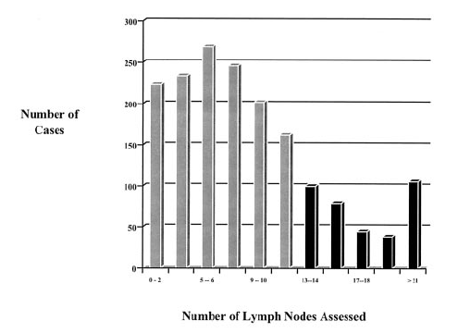
The “Gap”
5% nodal harvest not stated
4% no nodes recovered
Median nodal recovery = 8 nodes
Only 27% had 12 or more nodes recovered
Wright Ann Surg Onc 2003; 10:903-9

Slide 33
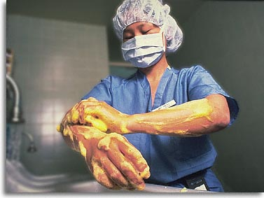
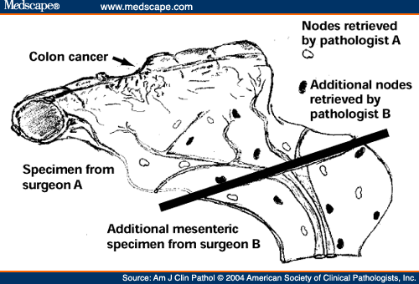
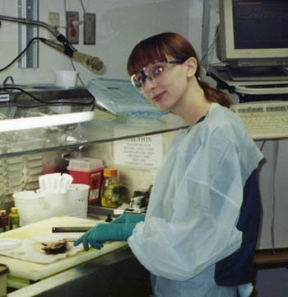
Principle of Surgery:
It’s a Team Sport!

Slide 34
Compliance with Lymph Node Retrieval Guideline – Ontario Data

Slide 35
Sept 13, 04
Up to Nov 7, 05
Lymph Node Talk – Dr A Smith
Evidence on 12 nodes
Importance of Pathology and Surgery working together
Clinical implications to patients
Support from RVP of CRRCC and hospital to secure resources for Pathology Assistants
-Visual Aids supplied to Labs (Dr Smith)
-Intro of special techniques (e.g LN revealing solution)
-Increased dialogue between Pathologists and Surgeons
-Pathology Assistants joining team
-Less variability in dissection techniques
-Pathology Assistants examining ALL cancer specimens

Slide 36
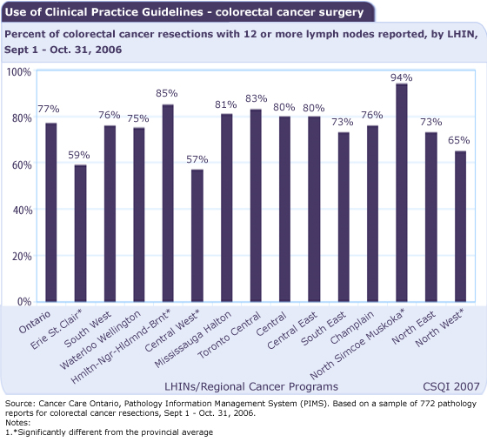

Slide 37

Main Message
CRC lymph node assessment/staging is increasingly relevant to surgeons
“Homegrown” solutions are integral part of Quality improvement
  Teamwork is essential
Staging is becoming more precise

Slide 38

How do we “do” multidisciplinary care in Ontario?
Evidence based guidelines generated in Ontario
Audit and feedback
Multidisciplinary Case Conferences
  Tumour Boards

Slide 39

Optimization of surgical and pathological quality performance
in radical surgery for colon and rectal cancer:
Lymph nodes and margins
Smith AJ, Driman DK, Spithoff K, McLeod R, Hunter A, Rumble RB, Langer B, and the Expert Panel on Colon and Rectal Cancer Surgery and Pathology
A Quality Initiative of the
Program in Evidence-Based Care (PEBC), Cancer Care Ontario (CCO)

Slide 40
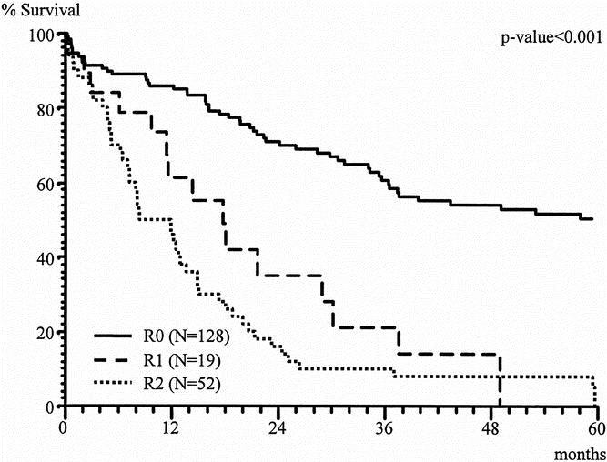
CRC cure requires R0 excision
In-continuity multivisceral resection is required to achieve R0 (negative margin) resection¹
Poor results if adherent organs “chipped off”^{2,3}
  local recurrence: 69% vs. 18%
  5 yr survival: 17% vs. 49%
1.Lehnert et al. Annals of Surgery. 2002
2.Hunter et al. Am J Surg. 1987
3.Gall et al. DCR. 1987

Slide 41
CRM should
be >1mm
Optimization of surgical and pathological quality performance
in radical surgery for colon and rectal cancer:
Lymph nodes and margins
A Quality Initiative of the
Program in Evidence-Based Care (PEBC), Cancer Care Ontario (CCO)

Slide 42

Population-based Assessment of the Surgical Management of Locally Advanced Colorectal Cancer
Govindarajan A, Coburn N, Kiss A,
Rabeneck L, Smith AJ, Law CHL
JNCI 2006

Slide 43
Multidisciplinary Cancer Conferences:
Implications for rectal cancer management

Slide 44
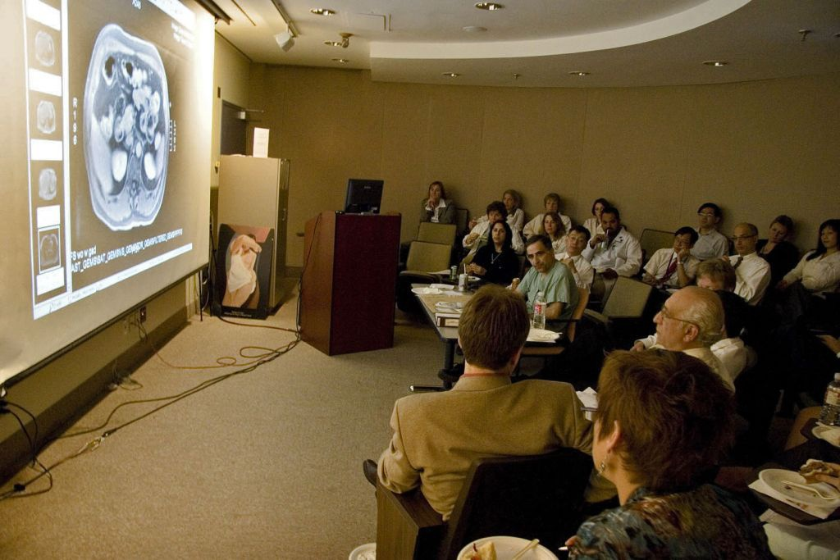
Definitions
Multidisciplinary Cancer Conference (MCC)
  Regularly scheduled meeting where representatives from surgery, medical oncology, radiation oncology, nursing, pathology, and diagnostic imaging discuss all appropriate diagnostic tests and suitable treatment options for an individual cancer patient (CCO 2006)

Slide 45
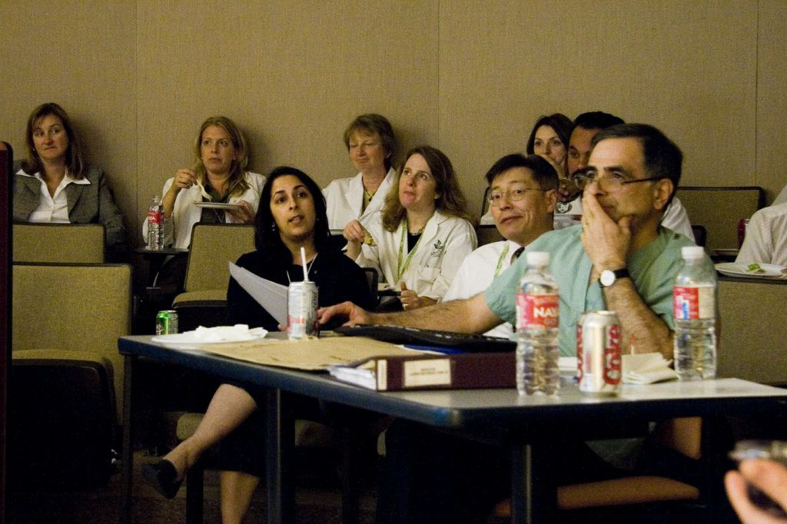
“Shouldn’t you use Chemotherapy first?”

Slide 46

Multidisciplinary Cancer Conferences
7-43% of the time after a patient’s case is discussed at MCC - the treatment plan will change (Chang 2001, Santoso 2004)
66-95% of all MCC recommendations are followed (Scholnik 1986, Petty 2002, Lutterbach 2005)

Slide 47




MCC - Where in the world?
UK
  After 1995 Calman-Hine report advocating MD care
US
  Required for accreditation by ACS, Commission on Cancer (50 years)
Australia
  2000 - National Demonstration Project using breast cancer

Slide 48
Ontario Tumor Boards: Standards
A working conference:
  usually weekly; ≥ 2/month
  ≥ 1 hour
  All new and recurrent cancer cases referred
Disciplines (in person or video-link):
  surgery, rad onc, med onc, pathology, radiology, nursing, (± pharmacist, social services, genetics, nutrition, pastoral care…)
Chair (coordinator):
  Selects cases for detailed discussion
  Reports to the head of the Cancer program
Physicians:
  Commit to attend and send cases
  Responsible for discussing with the patient, making the recommendations and documenting in the medical record
Wright FC, et al. 2007

Slide 49

CCO Standards
Primary Function
  Ensure all appropriate tests, treatment options and most appropriate treatment recommendations are generated for each cancer patient
MCC Cases
  Discussion at discretion of presenting physician, MCC chair

Slide 50
Conclusions
The idea that the process and structure of health care can improve patient outcomes is tantalizing
Very suggestive evidence of benefit
Optimal care - certainly to discuss a patient’s treatment plan in a multidisciplinary forum

Slide 51
Questions?

