Slide 1
Pre-operative medical problems
Mirek Otremba, MD
December 10, 2013
Director, UHN/MSH Medical Consult Service
On the web: Consult.otremba.org

Slide 2
Outline
Pre-operative Cardiac Assessment
Pre-operative Patient with a murmur (AS)
Pre-operative Patient with Hypertension

Slide 3
I.
Preoperative Cardiac Assessment
For
Non-Cardiac Surgery

Slide 4
Outline
Cardiac Risk Assessment
Stress Testing
Beta Blockers
Statins
Aspirin
Summary

Slide 5
Case Study
76 y.o. female for elective open hemicolectomy for colon cancer
Hx:
- CAD: MI 2 yr. ago, A. Fib.
- DM 2 for 10yrs, on oral agents, controlled
- Hypertension for 20 yrs, controlled
- Not active
Meds:
- metformin 500 mg bid
- diltiazem CD 240 mg OD
- ramipril 10 mg OD
- warfarin 4mg OD
Notes:
This patient has 15 points by the modified Index.
5 for prev. MI
5 forA. Fib.
5 for age.

Slide 6
Case Study
QUESTIONS:
1. Patient’s risk of perioperative MI or
cardiac death?
2. Are any investigations needed to further
evaluate her risk?
3. What interventions could you do that are
“proven” to reduce her perioperative risk?

Slide 7
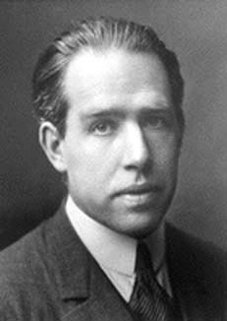
Predicting cardiac risk
"Prediction is very difficult, especially about the future."
Niels Bohr
Danish physicist (1885 - 1962)

Slide 8
Perioperative cardiac risk
2 major components
Surgery Specific Risk
Patient Specific Risk
This has been explored by Lee et al
Basis for the Revised Cardiac Risk Index

Slide 9
Surgical risk – AHA/ACC
Risk Stratification | Procedure Example
High (risk > 5%) | Aortic and other major vascular surgery
Intermediate (risk 1-5%) | Intraperitoneal Intrathoracic H&N surgery Orthopedic surgery
Low (risk <1%) | Endoscopic Breast

Slide 10
The Revised Cardiac Risk Index
Methods
4315 patients > 50 yrs for elective non-cardiac surgery
Outcomes: MI, CHF, VF or 1o cardiac arrest, CHB
Outcome assessment blinded
Lee TH et al. Derivation and Prospective Validation of a Simple Index for Predication of Cardiac Risk of Major Noncardiac Surgery. Circulation. 1999;100:1043-1049.

Slide 11
The Revised Cardiac Risk Index
Six independent clinical predictors identified:
High-risk surgery (vascular, intraperitoneal, intrathoracic)
Hx of Ischemic Heart Disease
Hx of CHF
Hx of CVD
DM on Preop Insulin Therapy
Preop Creatinine > 177 micromol/L (2.0 mg/dL)
Lee TH et al. Circulation. 1999;100:1043-1049.

Slide 12
The Revised Cardiac Risk Index
CLASS | EVENTS/PT’S | EVENT RATE %
I 0 RISK FACTORS | 2/488 | 0.4
II 1 RISK FACTORS | 5/567 | 0.9
III 2 RISK FACTORS | 17/258 | 6.6
IV ≥3 RISK FACTORS | 12/109 | 11.0
Low
Med
Hi

Slide 13
Rates of Major Cardiac Complications
Lee et al. Circulation. 1999;100:1043-1049
Percent
Procedure type

Slide 14
Combine Risk Index with an Algorithm
  Increase accuracy of prediction
  Guide clinical decision making

Slide 15
AHA 2007 Perioperative Cardiovascular Evaluation guidelines - OVERVIEW

Slide 16
Back To The Case Study
76 y.o. female for elective open hemicolectomy for colon cancer
Hx:
- CAD: MI 2 yr. ago, A. Fib.
- DM 2 for 10yrs, on oral agents, controlled
- Hypertension for 20 yrs, controlled
- Not active
Let’s run through the algorithm!
MEDS:
- metformin 500 mg bid
- diltiazem CD 240 mg OD
- ramipril 10 mg OD
- warfarin 4mg OD
Notes:
This patient has 15 points by the modified Index.
5 for prev. MI
5 forA. Fib.
5 for age.

Slide 17
AHA 2007 Guidelines
Class I, LOE C
Need for emergency non cardiac surgery?
Yes
Step 1
Operating room
No
Perioperative surveillance and postoperative risk stratification and risk factor management
Step 2

Slide 18
AHA 2007 Guidelines
Class I, LOE B
Yes
Evaluate and treat per ACC/AHA guidelines
Step 2
Active cardiac conditions?
Unstable coronary syndromes
Decompensated HF
Significant arrhythmias
Severe Valvular Disease
No
Consider operating room
Step 3

Slide 19
AHA 2007 Guidelines
Class I, LOE B
Low Risk Surgery?
Yes
Proceed with Planned Surgery
Step 3
No
Step 4

Slide 20
AHA 2007 Guidelines
METS ≥ 4
Class I, LOE B
Good functional capacity without symptoms?
Yes
Step 4
Proceed with Planned Surgery
No or Unknown
Step 5

Slide 21
Metabolic Equivalents
Decreasing physical ability (amount of blocks walked or stairs climbed) increases peri-operative complications!

Slide 22
AHA 2007 Guidelines
CAD
CHF
Stroke
Diabetes (on insulin)
Renal insufficiency
Class I, LOE B
Calculate Lee risk factors (RCRI*)
None
Proceed with Planned Surgery
Step 5
3 or more
1 or 2
Vascular Surgery
Intermediate Surgery
Vascular Surgery
Intermediate Surgery
* Revised Cardiac Risk Index

Slide 23
AHA 2007 Guidelines
Step 5
3 or more
1 or 2
Vascular Surgery
Intermediate Surgery
Vascular Surgery
Intermediate Surgery
β Blockade
AND
Consider testing if it will change management
Proceed with planned surgery with HR control
OR
consider non-invasive testing
if it will change management
Class IIa, LOE B
Class IIb, LOE B
Class IIa, LOE B

Slide 24
Stress testing
Perform stress test only if it will change your management:
  Advise about risk
    Informed patient
    Intraoperative management
    Post-operative care setting/monitoring
  Advise about possible pre-op treatment
    CABG or PCI
Either dobutamine echo or mibi or persantine mibi.
Most cannot tolerate exercise stress – those who could usually fit enough not to need stress test in first place

Slide 25
Case: You decide to perform a dobutamine sestamibi:
What do you do with these 3 scenarios
Small fixed inferior wall defect. Small area of peri-infarct reversibility?
Large, severe intensity reversible defect, inferior wall?
Multiple areas of severe intensity reversibility?

Slide 26
Perioperative β-blockers
Continue β-blockers periop (Class I)
Vascular surgery patient (Class IIa)
  With ischemia or CAD
  No CAD but 1 or more RCRI risk factors present
Intermediate risk patient (Class IIa)
  With CAD or 1 or more RCRI risk factors present
Start early pre-op
  > week before
Achieve a steady state with adequate heart rate/blood pressure control
Use bisoprolol (or atenolol)

Slide 27
POISE: PeriOperative ISchemic Evaluation trial
Lancet 2008
RCT
Metoprolol CR 100 mg, escalated to 200mg after 12 hours
  Day of surgery (2-4 hrs pre)
  Up to 30 days post op treatment
  n = 4174
vs placebo n = 4177
Major non-cardiac surgery
Outcome: 30 day composite of cardiac events
  MI, cardiac arrest, CV death
POISE study group. Lancet 2008; 371(9627):1839-47

Slide 28
POISE – 1⁰ outcome
Placebo 6.9%
Metoprolol 5.8%
p = 0.04
Day 30
POISE study group. Lancet 2008; 371(9627):1839-47

Slide 29
POISE – Side Effects
 | Placebo | Metoprolol | P
Hypotension | 9.7% | 15% | <0.0001
Bradycardia | 2.4% | 6.6% | <0.0001
POISE study group. Lancet 2008; 371(9627):1839-47

Slide 30
POISE – Secondary Outcomes
 | Placebo | Metoprolol | P
Total Mortality | 2.3% | 3.1% | 0.03
Stroke | 0.5% | 1.0% | 0.005
POISE study group. Lancet 2008; 371(9627):1839-47

Slide 31
DECREASE-IV
Annals of Surgery
RCT
Bisoprolol 2.5mg
  Started on average 34 days pre-op
  n = 533
vs placebo
  n = 533
Major non-cardiac surgery (intermediate risk 1-6%)
Outcome: 30 day composite of cardiac events
  MI, CV death
Dunkelgrun M, et al. Ann Surg 2009;249: 921–926

Slide 32
DECREASE-IV – 1⁰ outcome
Placebo 6.0%
Bisoprolol 2.1%
p = 0.002
Dunkelgrun M, et al. Ann Surg 2009;249: 921–926

Slide 33
DECREASE IV – Secondary Outcomes
 | Placebo | Bisoprolol | P
Total Mortality | 3.0% | 1.8% | ?
Stroke | 0.6% | 0.8% | 0.68
Dunkelgrun M, et al. Ann Surg 2009;249: 921–926

Slide 34
Determine eligibility for statins
Follow current and everchanging guidelines
It’s all about the LDL!
Each unit of LDL is worth about 20% relative CV risk reduction LONG TERM
Peri-op risk reduction
  Possibly in vascular surgery (DECREASE III)
  Unsure in other (DECREASE IV)
  Start early pre-op (DECREASE – 30+ days preop)

Slide 35
DECREASE III DECREASE IV
Vascular sx (risk 5%+) Non-vascular sx (risk 1-5%)
Cardiac death or nonfatal myocardial infarction
P-value 0.03
Placebo 10.1%
4.9%
Fluvastatin 4.8%
3.2%
Days after surgery
Schouten O, et al. N Engl J Med 2009;361:980-9
Dunkelgrun M, et al. Ann Surg 2009;249: 921–926

Slide 36
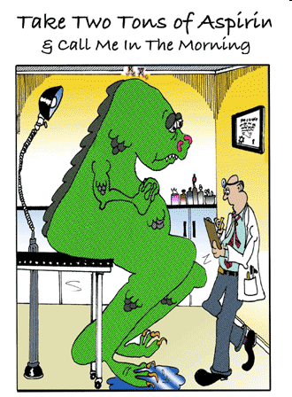
Aspirin
Don’t forget to continue the aspirin in patients going for vascular surgery
Coronary Stents have
special requirements for
antiplatelet continuation
  ASA should be continued at the minimum in most patients
  Talk with the cardiologist that put the stent in

Slide 37
Summary
Cardiac Risk Assessment is a mix of Evidence and Art
Patients who need β - blockers need β – blockers but who benefits for preriop risk reduction is still being debated
Patients who need statins need statins perioperatively
Patients’ aspirin should be continued during vascular surgery and in patients with cardiac stents
Symptomatic patients who meet AHA criteria for CABS/PTCA usually should get it before elective noncardiac surgery. Asymptomatic patients may not benefit
Refer to pre-op clinics for optimization early

Slide 39
II.
Perioperative management of Aortic Stenosis

Slide 40
Case
55 year old male
For aorto-bifem bypass
Dyspnea on mild-moderate exertion
Smoker, DM2, HTN, “Heart Murmur”
ASA, Amlodipine, metformin

Slide 41
Case ctd
Obese
BP 130/65
JVP 3 cm
Chest – clear
Harsh systolic Murmur 3/6 at base
Soft S2
Poor carotid upstroke
Poor distal pulses with bruits over femorals

Slide 42
Case ctd
CXR – enlarged heart
ECG – LVH
Bloodwork – no major abnormalities
What investigations would you order and why?
What is his risk of this surgery?
How would you treat him?

Slide 43
Aortic Valve Disease Prevalence
2-9% of adults > 65 years of age have AS
1-2% of general population has
bicuspid aortic valve

Slide 44

Grading Aortic Stenosis
AS severity | AVA (cm²) | Mean Gradient (mm Hg) | Peak Gradient (mm Hg)
Normal | 3 - 4 | - | -
Mild | > 1.5 | < 25 | < 36
Moderate | 1 - 1.5 | 25 - 40 | 36 - 64
Severe | < 1.0 | > 40 | > 64

Slide 45
Cardiac Event Risk with AS
Study/Year | RR
Goldman 1977 | 3.2
Rohde 2001 | 6.8
Kertai 2004 | 5.2

Slide 46
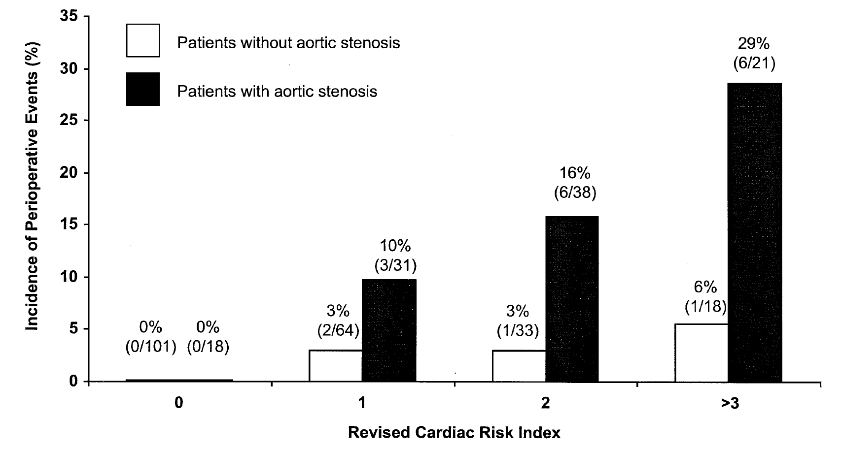
Cardiac Events by Risk Index Score
Kertai, 2004

Slide 47
Risk factors for outcome
Severity of AS
Presence of concomitant CAD
  50% of patients with AS may have CAD
  LV dysfunction
Severity of surgical procedure
  Volume shifts
  Perfusion/hypotension
  High risk: aortic/major vascular, prolonged, emergent

Slide 48
Preoperative Risk Evaluation
History
Physical Exam
  Functional murmurs are common
  AS
    Soft S2
    Ejection click
    S4
    mid frequency SEM
    Parvus et tardus pulse
    Sustained cardiac apex
Aortic area
Mitral area

Slide 49
Role of Echocardiography
Detect Severity of AS
Etiology of AS
  Bicuspid vs. calcific
LVH
Systolic dysfunction
Other valvular disease

Slide 50
Endocarditis Prophylaxis
Aortic Stenosis no longer considered a moderate risk lesion warranting bacterial endocarditis prophylaxis according to latest guidelines (AHA 2007)

Slide 51
Indications for Valve Replacement
Paucity of data
Same as in the absence of surgery
NB need for anticoagulation especially with mechanical heart valves
Combined versus staged approach?
  Neurosurgery (bleeding vs. stroke risk)

Slide 52
Management of Anaesthesia
Ventricular filling is pre-load dependent
Atrial fibrillation is poorly tolerated
LVH reduces coronary reserve
  Hypotension may result in cardiac ischemia
    Keep DBP > 60
  Treat hypotension with alpha agonists
Laparoscopic abdominal surgeries are higher risk (pre-load)
Pain management/epidural

Slide 53
Valvuloplasty
Complication rate 10-20%
  Stroke
  AI
  MI
Restenosis
Unclear role
?TAVI (Transcatheter Aortic Valve Implantation)

Slide 54
ACC/AHA
Severe aortic stenosis poses the greatest risk for non cardiac surgery
If the aortic stenosis is severe and symptomatic, elective non cardiac surgery should generally be postponed or cancelled
Such patients require aortic valve replacement before elective but necessary non cardiac surgery

Slide 55
Back to the case
2D echo
  LVH
  Peak gradient 96/Mean 64 mm Hg
  Normal systolic function
  How does this affect your risk assessment?
  What would you do now?

Slide 56
Case ctd
Delay surgery – high risk
Cardiac Cath
Normal systolic function
Proximal RCA 80% stenosis
LAD 30%
Plan?

Slide 57
Summary
Severe AS is an independent risk factor for adverse events perioperatively
Strongly consider valve replacement in patient with severe AS (Mean Gradient > 40mmHg)
Ballon valvuloplasty not recommended routinely. TAVI an emerging technology
Look for CAD
  Need for cath especially with decreased LVEF or WMA?
?Beta blockers for patients at risk for CAD
  Mild-moderate AS only

Slide 58


Slide 59
III.
Peri-operative hypertension

Slide 60
Perioperative Management of the Hypertensive Patient
Overview
  Background
  Classification of hypertension
  Association between hypertension and perioperative cardiovascular outcomes
  Perioperative management of patients with hypertension or raised arterial pressure
Notes:
Overview.
Questions?

Slide 61
Perioperative hypertension
Is hypertension associated with increased perioperative risk?
How important is elevated BP at the time of surgery wrt to cardiovascular events?
Does treatment at the time of surgery decrease risk of cardiovascular events?
How should hypertension in the surgical patient be treated?

Slide 62
Why is high blood pressure important?
Worldwide 26% of adults had hypertension (data from yr. 2000)
Most are not well-controlled
Every increase in 20 mmHg SBP/10 mmHg DBP doubles the risk of cardiovascular complications (CAD, CHF, CRF, CVA)
Elevated preoperative BP most common reason surgery is cancelled
Notes:
Overall, 26·4% (95% CI 26·0–26·8%) of the adult population in 2000 had hypertension (26·6% of men [26·0–27·2%] and 26·1% of women [25·5–26·6%]), and 29·2% (28·8–29·7%) were projected to have this condition by 2025 (29·0% of men [28·6–29·4%] and 29·5% of women [29·1–29·9%]). The estimated total number of adults with hypertension in 2000 was 972 million (957–987 million); 333 million (329–336 million) in economically developed countries and 639 million (625–654 million) in economically developing countries. The number of adults with hypertension in 2025 was predicted to increase by about 60% to a total of 1·56 billion (1·54–1·58 billion).
Global burden of hypertension: analysis of worldwide data
Patricia M Kearney MDa, d, Megan Whelton BSa, Kristi Reynolds PhDa, Paul Muntner PhDa, b, c, ProfPaul K Whelton MDa, b, c and Prof, DrJiang He MDa,
Volume 365, Issue 9455, 15 January 2005, Pages 217-223

Slide 63
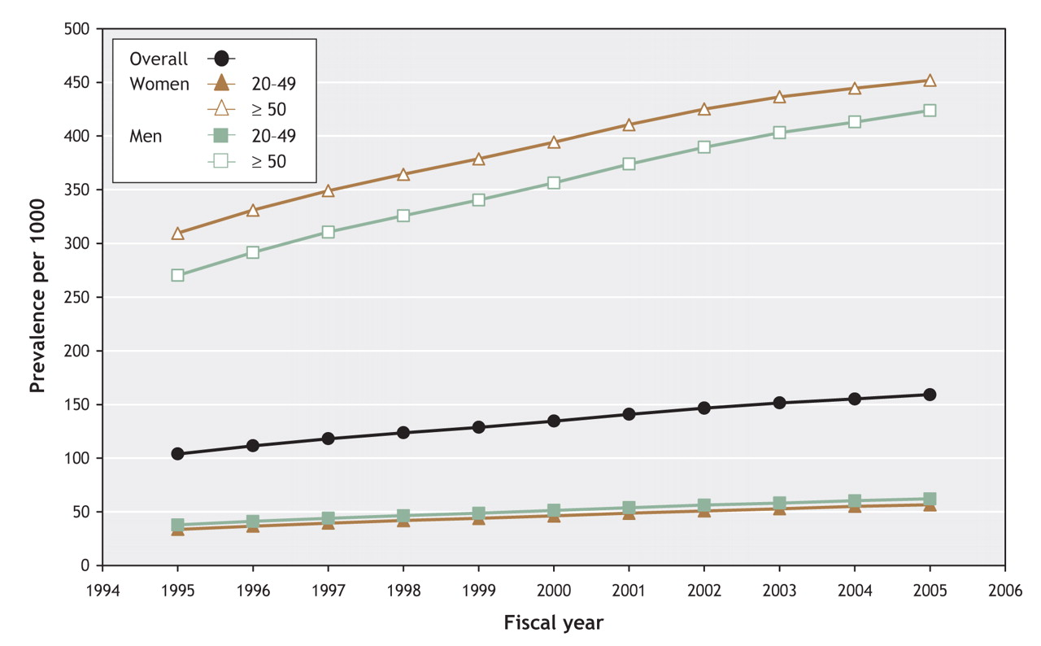
Prevalence of hypertension in Ontario 1995-2005
Tu, K. et al. CMAJ 2008;178:1429-1435
≥50 yo
average
<50 yo
Notes:
Figure 1: Prevalence of hypertension in the province of Ontario from 1995 to 2005. We used a logistic regression model to adjust for age, sex, residence location (urban v. rural), socioeconomic status, presence of diabetes, 5-year history of cardiovascular disease, Charlson Comorbidity Index score, and interaction terms between age and sex. Yearly rates are based on prevalence as of Mar. 31 of each year. Results of the Pearson correlation test p < 0.001.
Tu, K. et al. CMAJ 2008;178:1429-1435

Slide 64
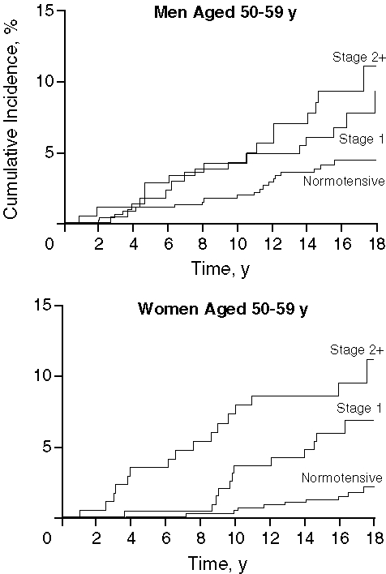
Framingham: HTN ⇒ CHF
Levy et al.,JAMA 1996. 275
Notes:
Figure 1. Cumulative incidence of congestive heart failure in men and women aged 50 to 59 years according to hypertension status at baseline. Stage 1 hypertension was defined as systolic blood pressure of 140 to 159 mm Hg or diastolic blood pressure of 90 to 99 mm Hg in subjects not receiving antihypertensive treatment, and stage 2 or greater hypertension (stage 2+) was defined as systolic blood pressure greater than 160 mm Hg, diastolic blood pressure greater than 100 mm Hg, or the current use of antihypertensive treatment.
The Progression From Hypertension to Congestive Heart Failure
Levy, Daniel MD; Larson, Martin G. ScD; Vasan, Ramachandran S. MD; Kannel, William B. MD, MPH; Ho, Kalon K. L. MD, MSc
JAMA:275(20), 22/29 May 1996, pp 1557-1562

Slide 65
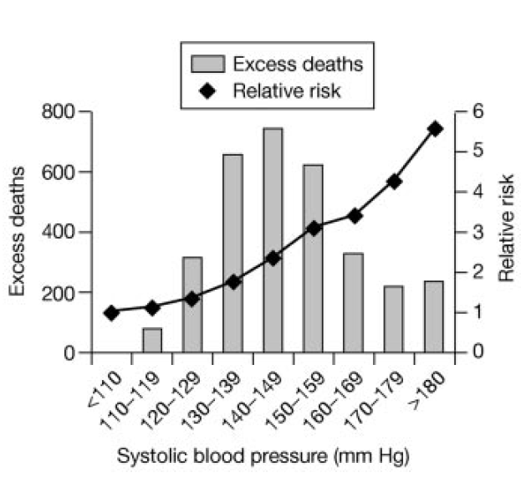
Mrfit: HTN ⇒ CAD
Stamler et al., 1993 Cardiology 82:191-222

Slide 66
Periop HTN History
Sprague 1929: the highest operative mortality rates were found in patients with “hypertensive cardiac disease”
Goldman and Caldera 1979: prospective study of hypertensive patients compared to healthy control patients.
  No significant risk provided DBP < 110 mmHg and intraoperative and postoperative hypo/hypertension was monitored and treated.
Notes:
General belief that hypertension was a strong indicator of increased risk for perioperative cardiac events.
Anesthesiology was much riskier in general at this time.1979 editorial in Anesthesia “attitudes towards the management of anesthesia and operation in hypertension patients have teneded to swing from one extreme to another”.
Generally thought HTN was a poor prognostic sign for operative risk.
1930’s hypertensive cardiac disease was thought to be a contraindication to surgery.
Sprague - study at the Massachusett’s General hospital:Retrospective analysis of 170 patients with surgery,of the 75 patients with “hypertensive cardiac disease” higher numbers died of cardiac failure (12/75 with 24/75 (34%) overall mortality).
1960’s: concerns re: hypertensive agents used reserpine and rauwolfia
Goldman and Caldera: mild to moderate HTN by the standards of the day (although now would be consider level I -II). Study limited by small numbers,and only five had DBP > 110 mmHg. Studies included higher risk surgeries (aortic cross clamping).

Slide 67

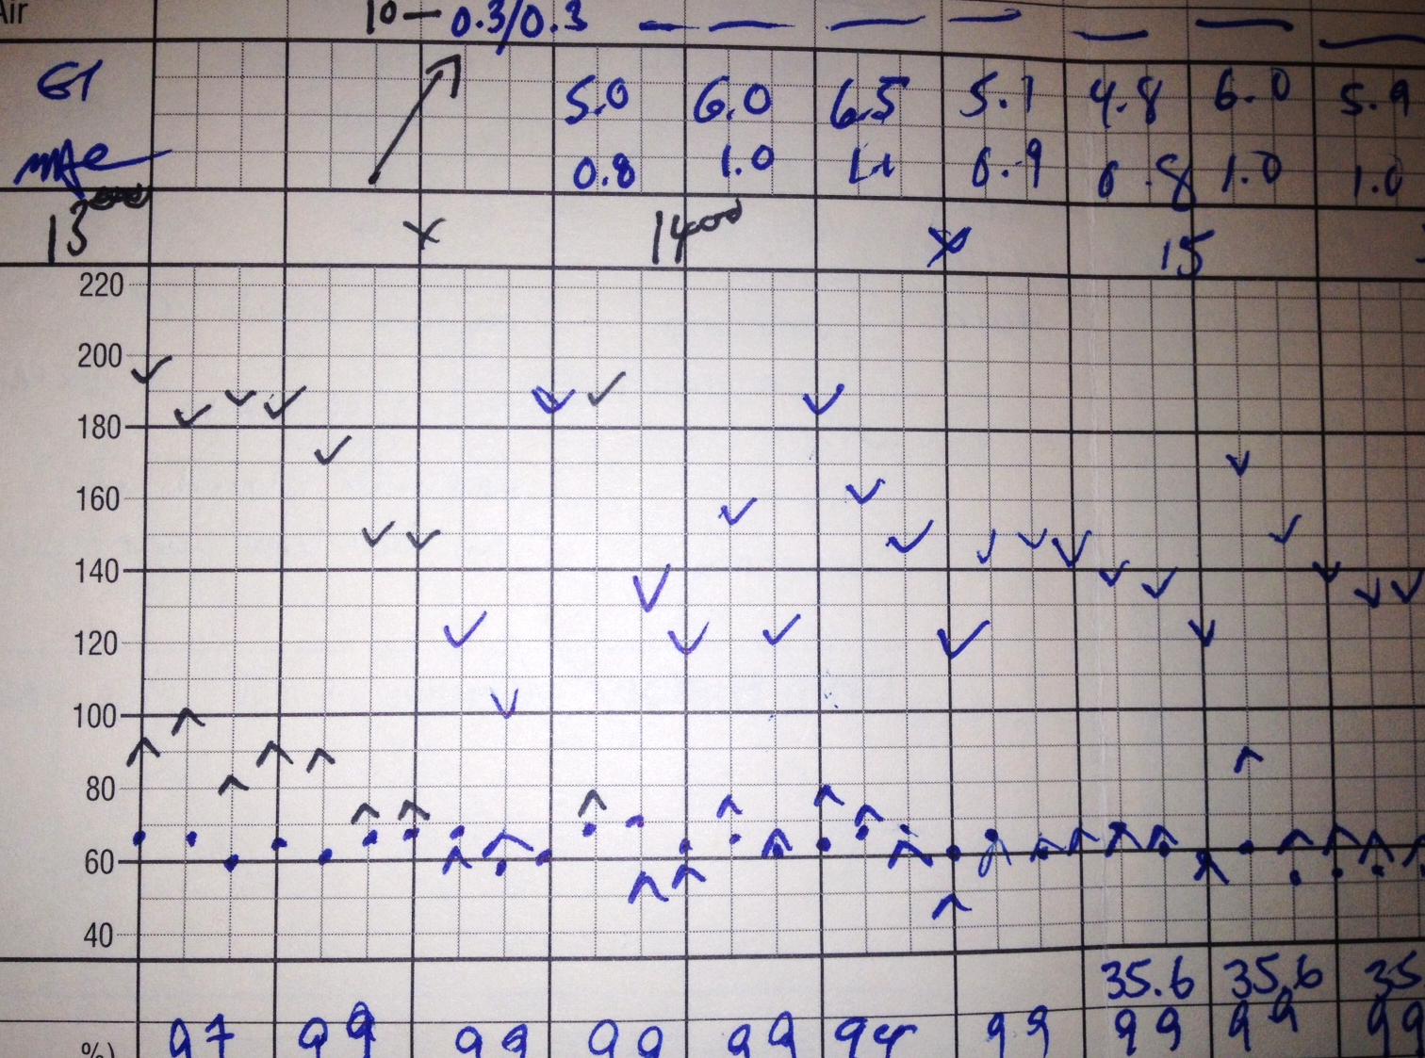
Alpine anaesthesia
A delta of SBP ~ 100 mmHg can’t be good!
Organ hypoperfusion likely
Beyond autoregulation levels

Slide 68
Conclusions from Goldman and Caldera
Increased BP lability and greater absolute decreases in intraoperative BPs.
Past severity of HTN predicted new hypertensive events better then preop values
Perioperative cardiac complications were greatly correlated with cardiac risk factors and not hypertensive disease.
No significant risk provided DBP < 110 mmHg and intraoperative and postoperative hypo/hypertension was monitored and treated
Notes:
Lacks statistical significance due to small numbers (small no of events)
Doesn’t look at severe HTN (which ismore likely to affect outcome)

Slide 69
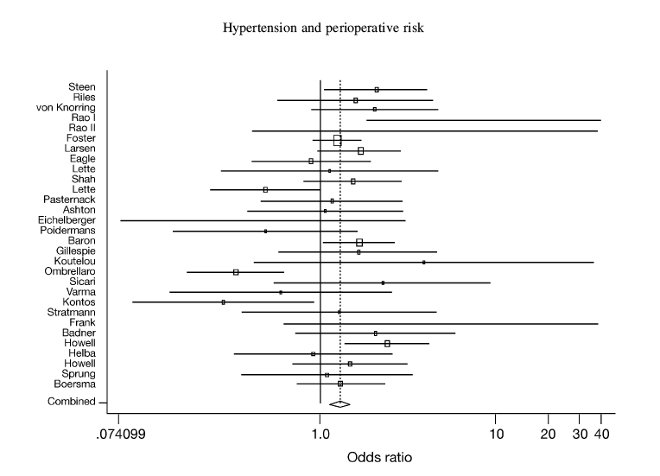
Forrest plot for risk of perioperative cardiovascular complications in hypertensive and normotensive patients
Howell et al., British Journal of Anesthesia, 2004, 92:570-83
Notes:
X axis is logarithmic scale. Solid vertical line is at unity, dotted vertical line at the combined estimate. Point estimate of OR indicated by box, size of box indicates weight given to study.
Studies published between 1978 and 2001 and included 12 995 patients.

Slide 70
Conclusion
Pooled OR 1.35 (1.17-1.56) p<0.001
“…in context of low perioperative event rate, this small odds ratio probably represents a clinically insignificant association..”
Notes:
Heterogeneity represents the extent or magnitude of differences in tretment or exposure effects between studies.
Small odds ratio, statistically significant BUT need caution in interpreting re heterogenous observation studies and no correction for confounders.
CONCLUSION: if pt otherwise ok (ie no acute symptoms of HTN) surgery should NOT be deferred based on arterial BPs alone.If greater then 180/110 surgery can proceed but patient should receive intraop treatment for cardiovascular stability.

Slide 71
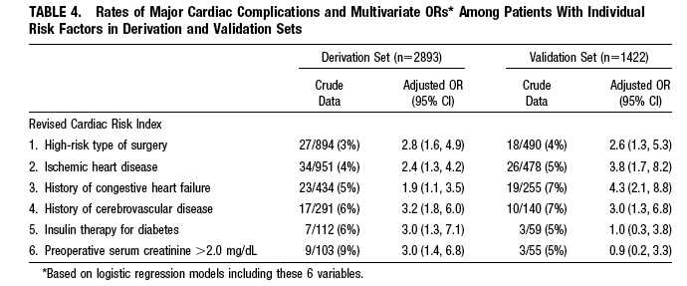
Perioperative management
End-organ damage (2⁰ to any cause, including HTN) is more predictive for adverse cardiovascular events.
RCRI
Notes:
End-organ damage (2 to any cause, including HTN) is more predictive for adverse cardiovascular events.

Slide 72
AHA/ACC guidelines
Stage I and II hypertension are not independent risk factors for cardiovascular complications
Stage III hypertension (SBP >179 mmHg and/or DBP >110 mmHg should be controlled prior to OR
Continue anti-hypertensive meds periop period
Notes:
Can delay OR and control hypertension OR if surgery is urgent then it can be treated effectively by rapid acting agents.
BUT not supported by data - best management is unclear

Slide 73
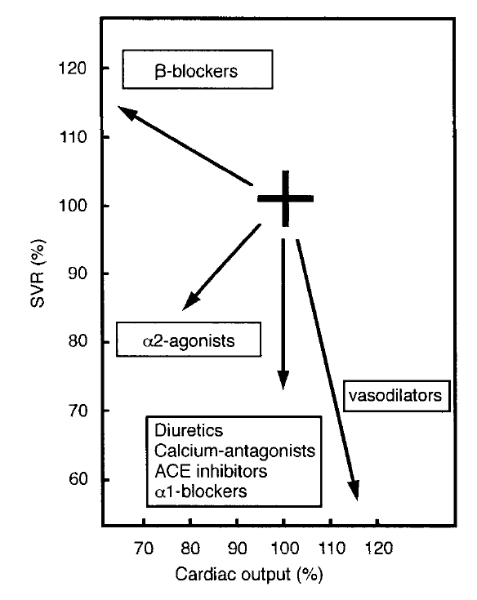
Hemodynamic effects of various groups of anti-HTN agents
Boldt J Bailliere’s Clinical Anaesthesiology 1997 Dec Vol 11. No 4

Slide 74
Management of patients on chronic antihypertensive therapy
Continue oral medications perioperatively (with some exceptions)
Abrupt discontinuation of some meds (B-blockers, clonidine, methyldopa) may result in rebound hypertension or tachycardia
Risks associated with severe uncontrolled hypertension (stroke, MI)

Slide 75
Recommendations
Class of drug | Clinical considerations | Recommendations
Beta blockers | Withdrawal can result in tachycardia, hypertension and ischemia. Bradycardia | Possibly prevents postop ischemia: Continue
Alpha 2 agonists | Withdrawal can cause extreme hypertension and ischemia | Continue throughout periop period
CCB | Withdrawal tachycardia. Bradycardia | Continue
ACE-I and ARBS | Hypotension. Possible renoprotection | Continue if only anti-HTN; in general stop
Diuretics | Hypovolemia, hypotension, K derrangements | Hold day of surgery

Slide 76
Patient hypertensive pre-op
Choose meds per current hypertension guidelines and those that can be continued periop
BP target < 160/100
Preferred meds
  Beta blockers – bisoprolol, atenolol
  CCB – amlodipine, diltiazem CD

Slide 77
If NPO…
B-blockers: labetalol, metoprolol
ACE-I: enalaprilat
Central acting agents: clonidine patch
CCB: nicardipine IV
NTG patch
Hydralizine
Avoid hypervolemia ➔ increase BP

Slide 78
Summary
No major association between uncontrolled hypertension in the surgical patient and cardiovascular events
Guidelines around deferring surgery are vague
Certain Antihypertensive medications must be continued throughout the surgical stay

